Slide 2
In the beginning, God created the heavens and the earth…

Slide 3
The earth was without form and void, and darkness was over the face of the deep.
– Gen. 1:2a
Drawings courtesy of Nicole Manuel

Slide 4
And the Spirit of God was hovering over the face of the waters.
Gen. 1:2b
Drawings courtesy of Nicole Manuel

Slide 5
And God said, ‘Let their be light’. Gen. 1:3
Drawings courtesy of Nicole Manuel

Slide 6
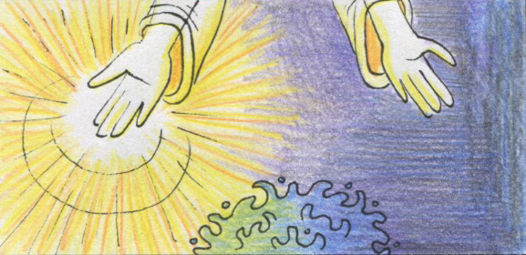
God saw that the light was good. And God separated the light from the darkness. God called the light ‘Day’, and the darkness He called ‘Night’. And there was evening and there was morning, the first day. Gen. 1:4 - 5
Drawings courtesy of Nicole Manuel

Slide 7
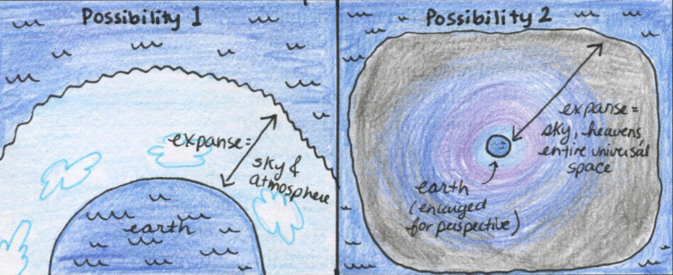
And God said, Let there be an expanse in the midst of the waters... And God called the expanse ‘Heaven’. And there was evening and there was morning, the second day. Gen. 1:6-8
Drawings courtesy of Nicole Manuel

Slide 8
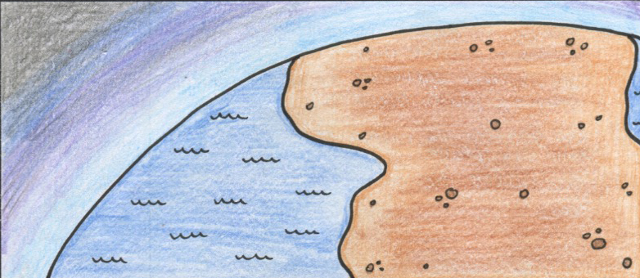
And God said, Let the waters under the heavens be gathered together into one place, and let the dry land appear… God called the dry land ‘Earth’ and the waters that were gathered together He called ‘Seas’.
Gen. 1:9 - 10
Drawings courtesy of Nicole Manuel

Slide 9
And God said, Let the earth sprout vegetation, plants yielding seed, and fruit trees bearing fruit, each according to its kind on the earth. And God saw that it was good.
Gen. 1:11 - 12
Drawings courtesy of Nicole Manuel

Slide 10
And there was evening and there was morning, the third day.
Gen. 1:13
Drawings courtesy of Nicole Manuel

Slide 11
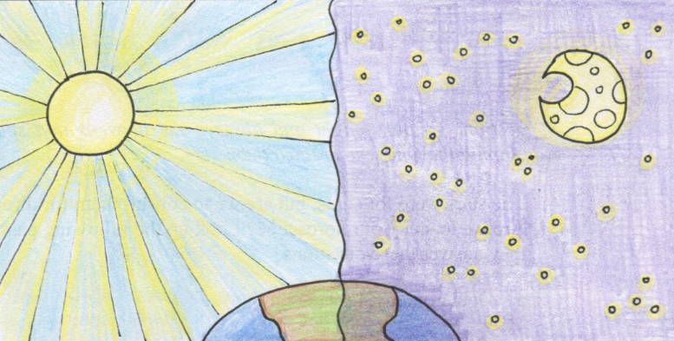
And God said, Let there be lights in the expanse of the heavens to separate the day from the night… and God made two great lights – the greater light to rule the day and the lesser light to rule the night – and the stars.
Gen. 1:16
Drawings courtesy of Nicole Manuel

Slide 12
And God saw that it was good. And there was evening and there was morning, the fourth day.
Gen. 1:18 - 19
Drawings courtesy of Nicole Manuel

Slide 13
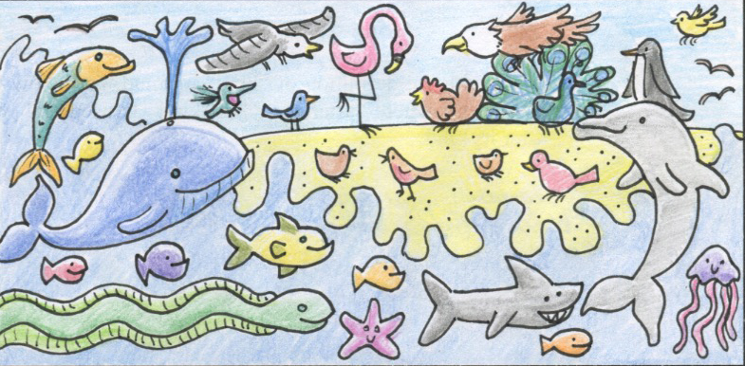
And God said, Let the waters swarm with swarms of living creatures, and let birds fly above the earth across the expanse of the heavens. And God saw that it was good.
Gen. 1:20 - 21
Drawings courtesy of Nicole Manuel

Slide 14
And God blessed them saying, Be fruitful and multiply and fill the waters in the seas, and let birds multiply on the earth. And there was evening and there was morning, the fifth day.
Gen. 1:22 - 23
Drawings courtesy of Nicole Manuel

Slide 15
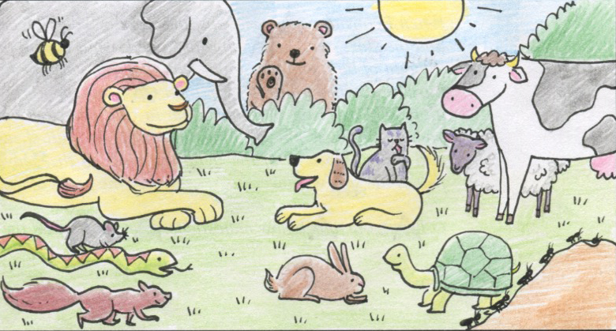
And God said, Let the earth bring forth living creatures according to their kinds – livestock and creeping things and beasts of the earth according to their kinds.
Gen. 1:24
Drawings courtesy of Nicole Manuel

Slide 16
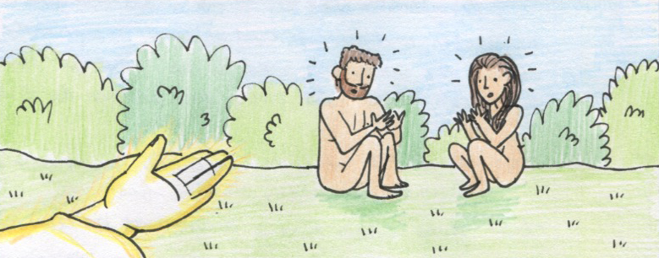
Then God said, Let us make man in our image, after our likeness. And let them have dominion over the fish of the sea and over the birds of the heavens and over the livestock and over all the earth and over every creeping thing that creeps on the earth.
Gen. 1:26
Drawings courtesy of Nicole Manuel

Slide 17
And God blessed them. And God said to them, Be fruitful and multiply and fill the earth and subdue it… And God saw everything that He had made, and behold, it was very good. And there was evening and there was morning, the sixth day.
Gen. 1:28 - 31
Drawings courtesy of Nicole Manuel

Slide 18
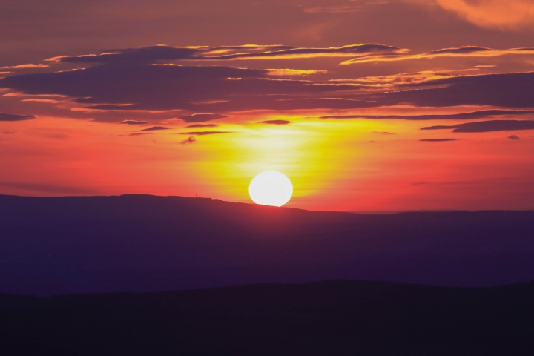
And on the seventh day, God rested…
Gen. 2:2

Slide 19
I. Reviewing Our Study in Genesis One

Slide 20
Reviewing Our Study in Genesis One
Clarification of the Two Books

Slide 21
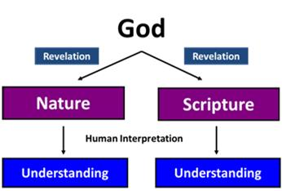
Hermeneutics:
The Science of Interpretation

Slide 22
Reviewing Our Study in Genesis One
Clarification of the Two Books
‘Biologos’ and Theistic Evolution

Slide 23
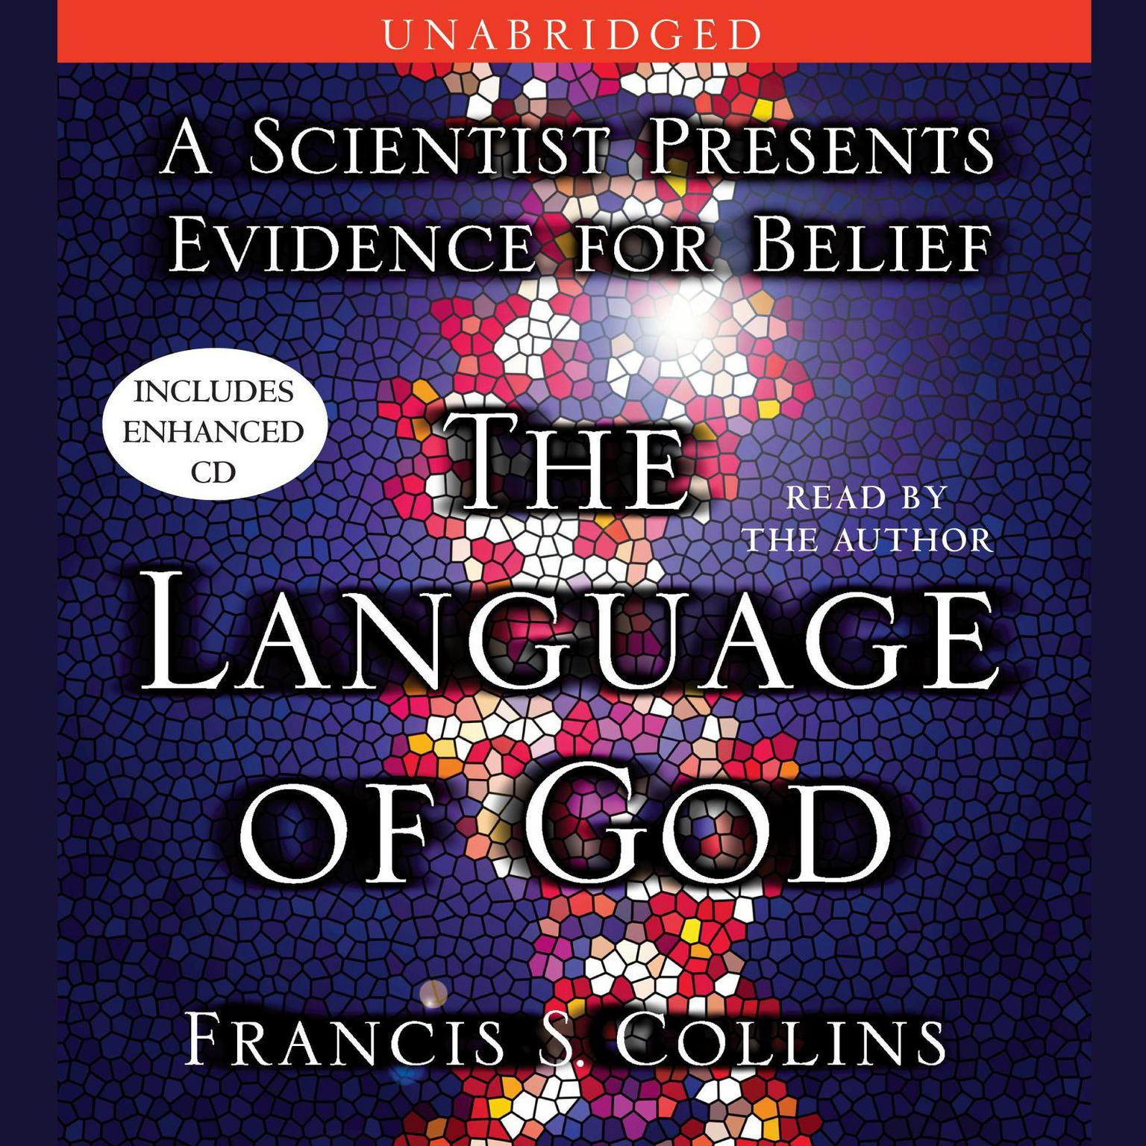
‘Theistic Evolution’?
Collins proposes - ‘Biologos’ – God is the source of all life and that life expresses the will of God.

Slide 24
Reviewing Our Study in Genesis One
Clarification of the Two Books
‘Biologos’ and Theistic Evolution
Three Views on Days of Creation

Slide 25
The Days of Creation:
The 24-Hour View
The Day-Age View
The Framework View

Slide 26
Reviewing Our Study in Genesis One
Clarification of the Two Books
‘Biologos’ and Theistic Evolution
Three Views on Days of Creation
Tōhû wābōhû – ‘without form and void’ (1:2)

Slide 27
Keys for Interpreting Days of Creation
Tōhû wābōhû – ‘without form and void’
Days 1 – 3: Forming Order from Chaos
Days 4 – 6: Filling the Emptiness

Slide 28
II. Revealing Personal Beliefs and Questions

Slide 29
Revealing Personal Beliefs and Questions
Truth: A Hermeneutical Concern for Integrity

Slide 30
Revealing Personal Beliefs and Questions
Truth: A Hermeneutical Concern for Integrity
Love: A Pastoral Concern for Unity

Slide 31
III. Reasserting what the Biblical Creation Account Teaches

Slide 32
Reasserting what the Biblical Creation Account Teaches
- What the Bible does NOT teach…

Slide 33
Reasserting what the Biblical Creation Account Teaches
What the Bible does NOT teach…
What the Bible DOES teach…

Slide 34
Without hesitation the ancient reader would conclude that this is a temple text and that day seven is the most important of the seven days… for Deity rests in a Temple and only in a Temple. This is what Temples were built for.
John H. Walton, The Lost World of Genesis One

Slide 35
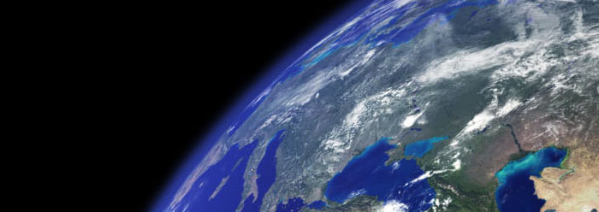
In the beginning was the Word, and the Word was with God, and the Word was God…All things were made through Him…
John 1:1f

Slide 36
By Him all things were created, in heaven and on earth, visible and invisible… all things were created through Him and for Him. He is before all things, and in Him all things hold together.
Col. 1:15 - 17

Slide 37
He is the radiance of the glory of God and the exact imprint of His nature, and He upholds the universe by the Word of His power.
Hebrews 1:3

