Slide 1
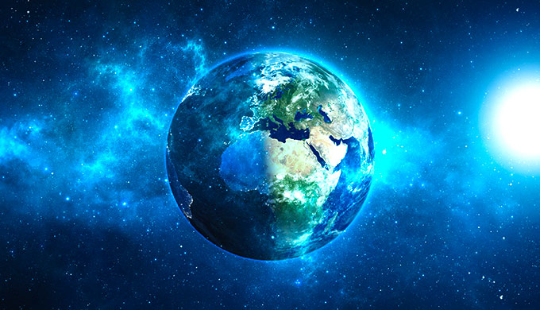
In the beginning, God created the heavens and the earth…

Slide 2
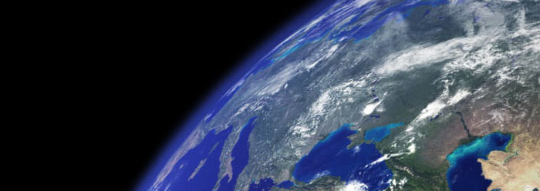
Scripture Reading:
Genesis 1: 1 - 5

Slide 3
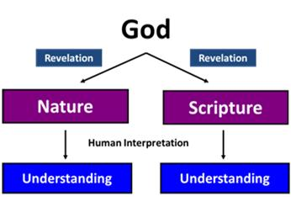
Hermeneutics:
The Science of Interpretation

Slide 4
Two Views on the Origins of Life
Genesis as Literature
Interpreting the Days of Creation
Genesis Text

Slide 5
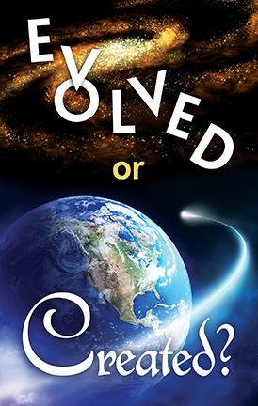
Origins of Life:
Creationism or Naturalism?

Slide 6
Biblical Creationism – God is the ultimate cause for the universe and all its life forms. (intelligent design)

Slide 7
Naturalism (atheistic or scientific) – the universe is viewed as eternal, self-governed and self-generating.
(random forces: Big Bang, evolution, natural selection etc)

Slide 8
It could be broken down even further…
- Creationism (God did it)
- Intelligent Design (God may have done it)
- Theistic Evolution (God used evolution)
- Atheistic Evolution (Natural science will explain everything)

Slide 9
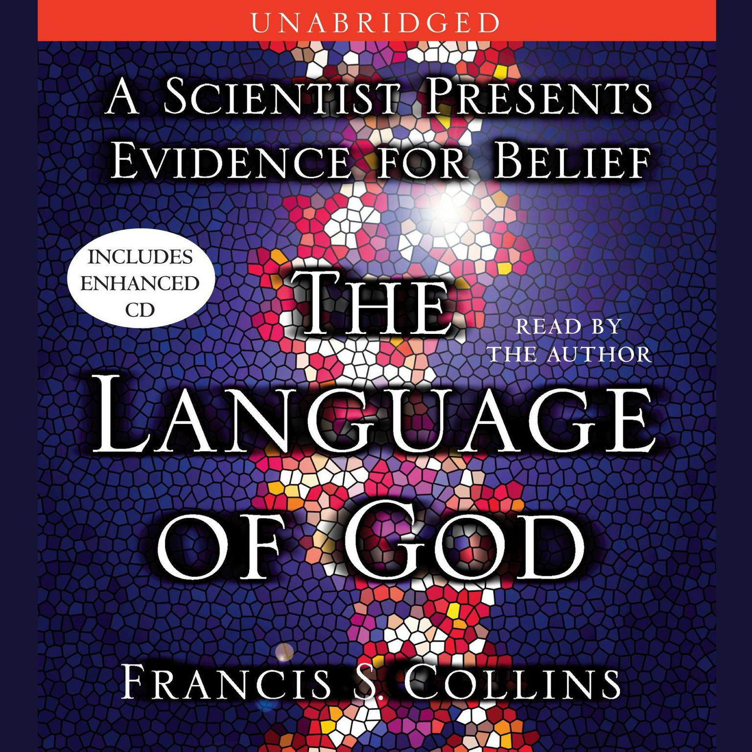
‘Theistic Evolution’?
Collins proposes - ‘Biologos’ – God is the source of all life and that life expresses the will of God.

Slide 10
‘The odds against a universe like ours emerging out of something like the Big Bang are enormous. I think there are clearly religious implications… It would be very difficult to explain why the universe should have begun in just this way, except as the act of a God who intended to create beings like us.’

Slide 11
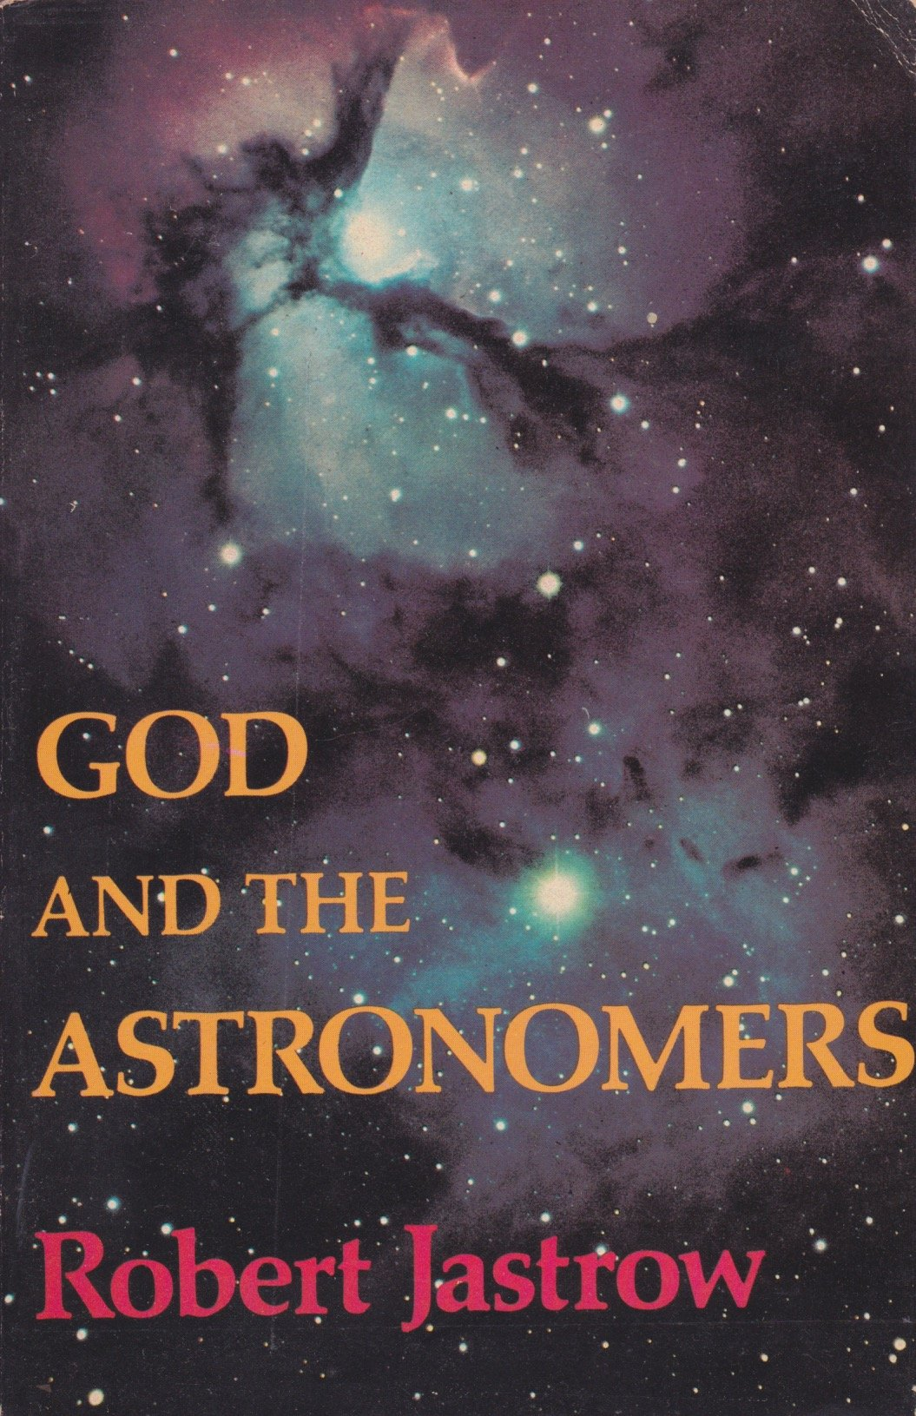
‘…it seems as though science will never be able to raise the curtain on the mystery of creation. For the scientist who has lived by his faith in the power of reason, the story ends like a bad dream. He has scaled the mountains of ignorance; he is about to conquer the highest peak; as he pulls himself over the final rock, he is greeted by a band of theologians who have been sitting there for centuries.’

Slide 12
‘I myself am convinced that the theory of evolution, especially the extent to which it is applied, will be one of the great jokes in the history books in the future. Posterity will marvel that so very flimsy and dubious a hypothesis could be accepted with the incredible credulity that it has.’

Slide 13
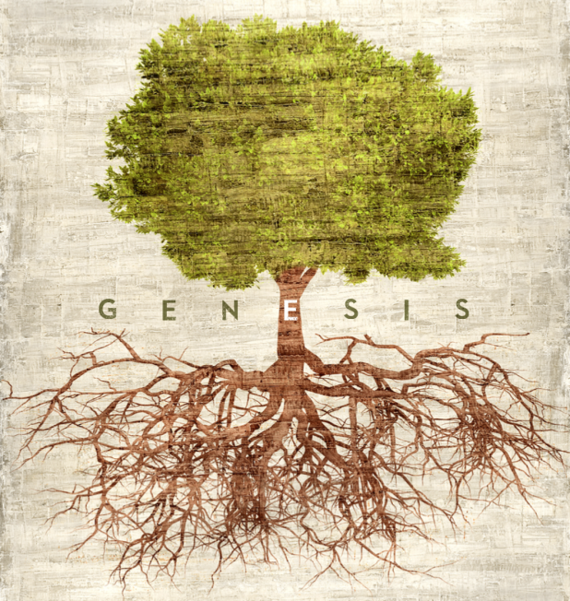
The Genesis Account

Slide 14
The Genesis Account
- Other Ancient Near Eastern Creation Accounts

Slide 15
The Genesis Account
Other Ancient Near Eastern Creation Accounts
The Torah (Genesis to Deuteronomy)

Slide 16
The Genesis Account
Other Ancient Near Eastern Creation Accounts
The Torah (Genesis to Deuteronomy)
Tólĕdót (12 Sections) – ‘These are the generations’

Slide 17
The Days of Creation:
The 24-Hour View
The Day-Age View
The Framework View

Slide 18
Keys for Interpreting Days of Creation

Slide 19
Keys for Interpreting Days of Creation
Tōhû wābōhû – ‘without form and void’

Slide 20
The description of the land as formless and empty plays a central role in the creation account because it shows the condition of the land before God’s gracious work has prepared it for humanity’s well-being. John H. Sailhamer

Slide 21
Keys for Interpreting Days of Creation
Tōhû wābōhû – ‘without form and void’
Days 1 – 3: Forming Order from Chaos
Days 4 – 6: Filling the Emptiness

Slide 22
What are we to take from our study of Genesis…

