Slide 3
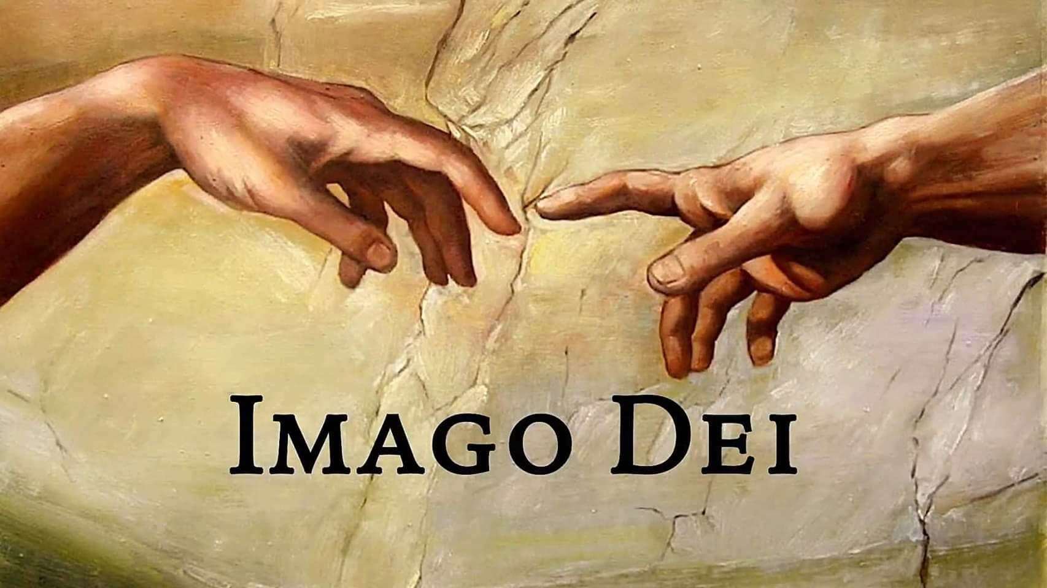
Genesis 1:26 - 31

Slide 4
Co-Rulers (Stewards of God’s Creation)
Co-Creators: Doing Work and Recreation that impact our world.
Co-Resters: Ceasing from work and observing Sabbath rest.
Spiritual Beings: Bodies formed by God; Souls filled with breath of God.
Rational / Moral Beings: Capacity to reason, feel and choose.
Relational Beings: Capacity for intimacy; to love and be loved.
Sexual Beings: Male and Female.

Slide 5
The message we need to give the world is that God made you a certain way, but sin made you the way that you are now; and God can re-make you in His way of grace and eternal life. - Kevin DeYoung

Slide 6
Scripture Reading: Genesis 2:1 – 17

Slide 7
Genesis 1:26 - 31

Slide 8
God formed man from the very dust of the ground
Humans created by a personal God with an intelligent design
DNA, atoms, molecules, hydrogen… not cause of Adam - only substance of body
‘Formed’ (vaster) means ‘to mold, shape or form’ (picture of a potter)
God breathed (ruach) into man’s nostrils the breath of life
Man became a living soul. - ‘Soul’ (nephesh) - means an animated, breathing, conscious, and living being, but also endowed with immortality.

Slide 9
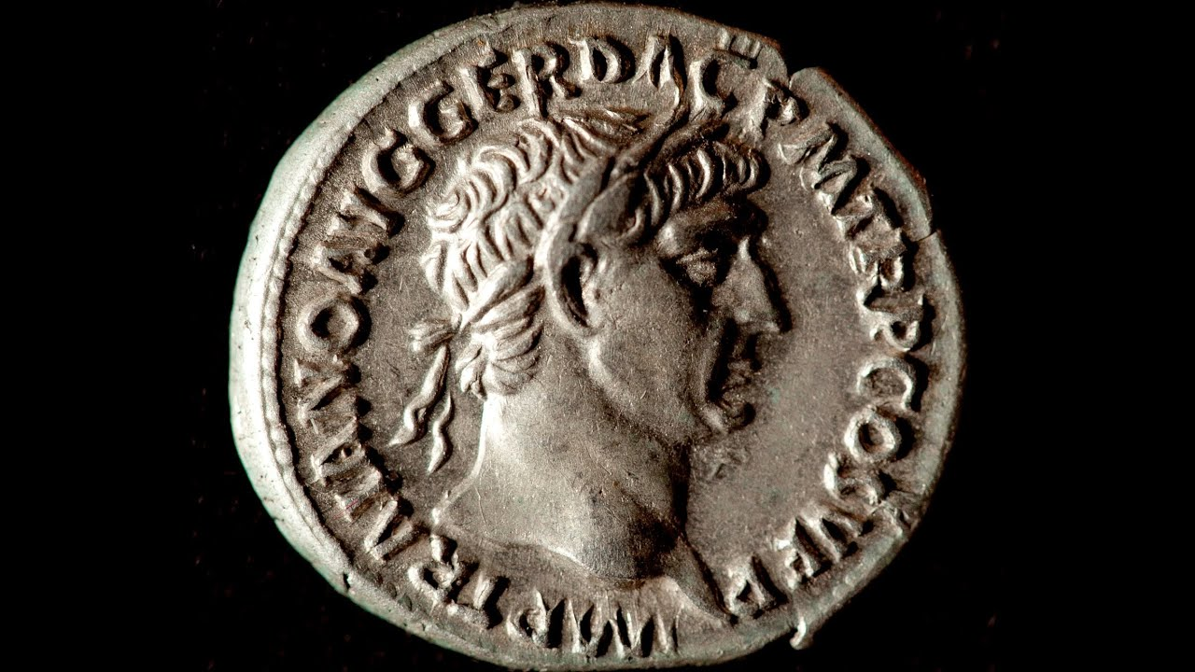
An Illustration from the life of Christ
- Mark 12:13 - 17

Slide 10
The point seems to be that people are in God’s image in spite of how deficient their attributes may be, not because they have good attributes.
- John F. Kilner

Slide 11
… the Bible gives us a grand narrative of a worldview story and each of the people of God should see himself (herself) as an heir of this story, with all its glory and shame; as a steward of the story, responsible to pass it on to the next generation; and as a participant whose faithfulness could play a role, in God’s mysterious wisdom, in the story’s progress.
- C. John Collins

