Slide 3
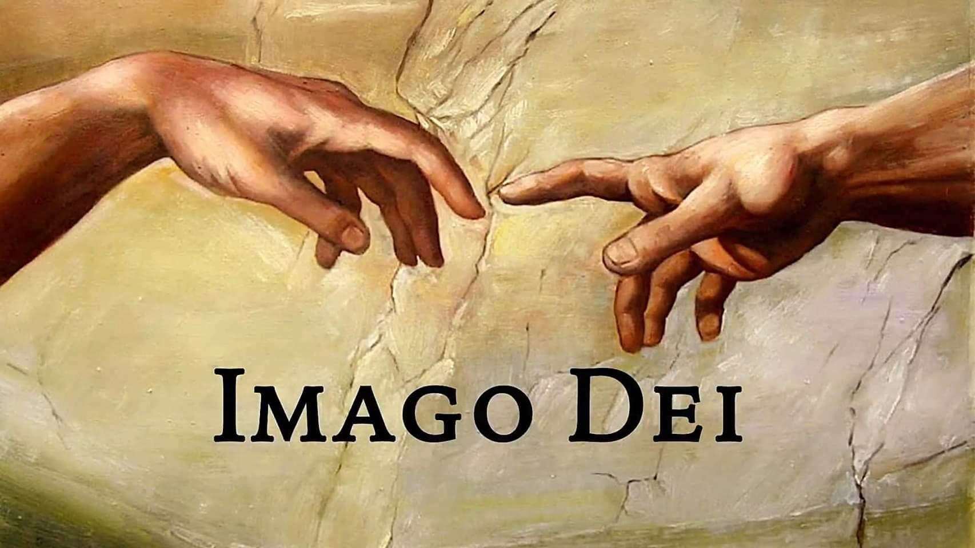
Genesis 1:26 - 31

Slide 4
Co-Rulers… having dominion
Co-Creators… working in God’s world
Co-Resters… observing Sabbath rest
Spiritual Beings… souls filled with breath of God
Moral Choice Beings… capacity / freedom to choose

Slide 5
Scripture Reading:
Genesis 2:4 – 17

Slide 6
1. Eden: An Invitation to the Garden of God

Slide 7
1. Eden: An Invitation to the Garden of God
2. Trees: Getting to the Root of the Imago Dei

Slide 8
1. Eden: An Invitation to the Garden of God
2. Trees: Getting to the Root of the Imago Dei
- Names of the Trees
- The Centre of the Garden
- Wisdom vs. Knowledge

Slide 9
1. Eden: An Invitation to the Garden of God
2. Trees: Getting to the Root of the Imago Dei
- Names of the Trees
- The Centre of the Garden
- Wisdom vs. Knowledge
3. The Choice: Self-image or God’s Image?

Slide 10
No choice is ever made without some degree of affection. Therefore affections are in the soul as the helm is in the ship; if it be laid hold on by a skillful hand, he turns the whole vessel which way he pleases… It is vain to contend with anything that has the power of our affections in its disposal; it will prevail at last. John Owen

Slide 11
O soul, you have thought ill of your God! You thought that because you have so often fallen that God was tired of you. You forget that His tender mercies are infinite, and that He will never let you go, never leave your side, never – until in heaven He kisses your face, where there will be no more effect of sin upon you. Your God will kiss your soul into health. F. B. Meyer

