Slide 3
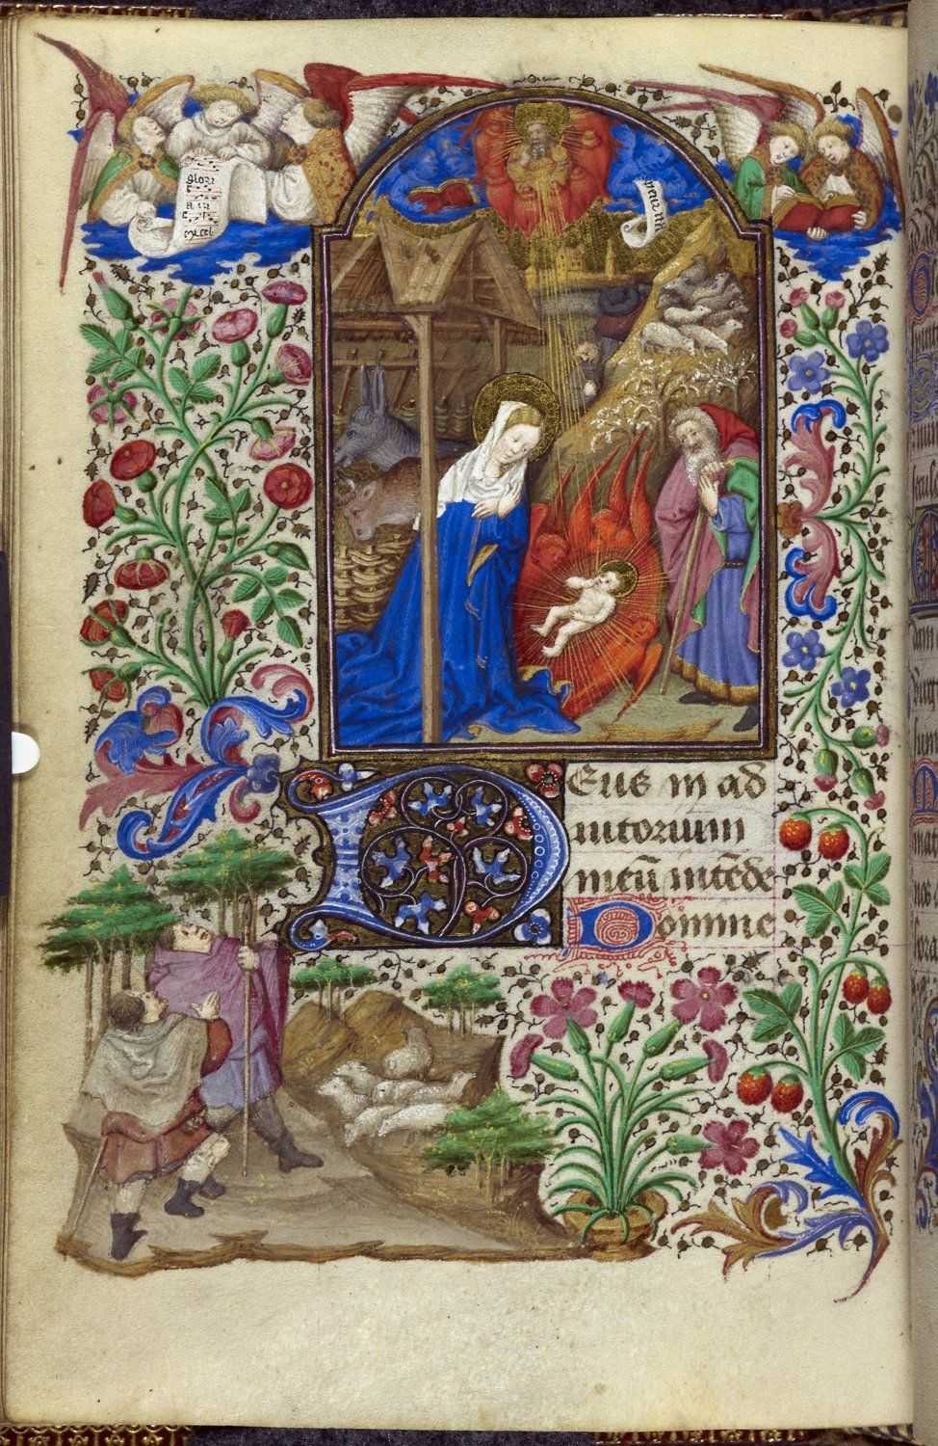

Slide 4
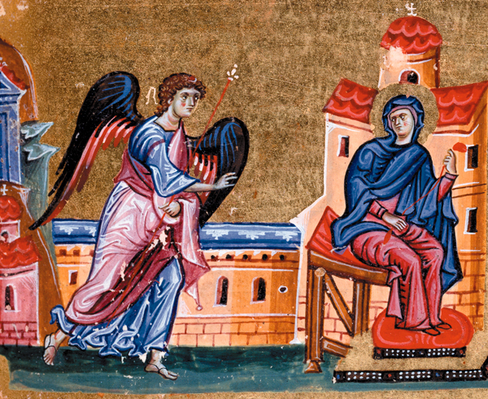
…the angel appears to Mary.
Luke 1:28

Slide 5
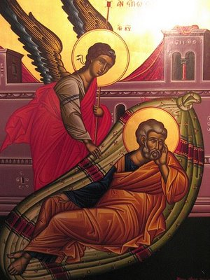
…the angel appears to Joseph in a dream.
Matthew 1:20

Slide 6
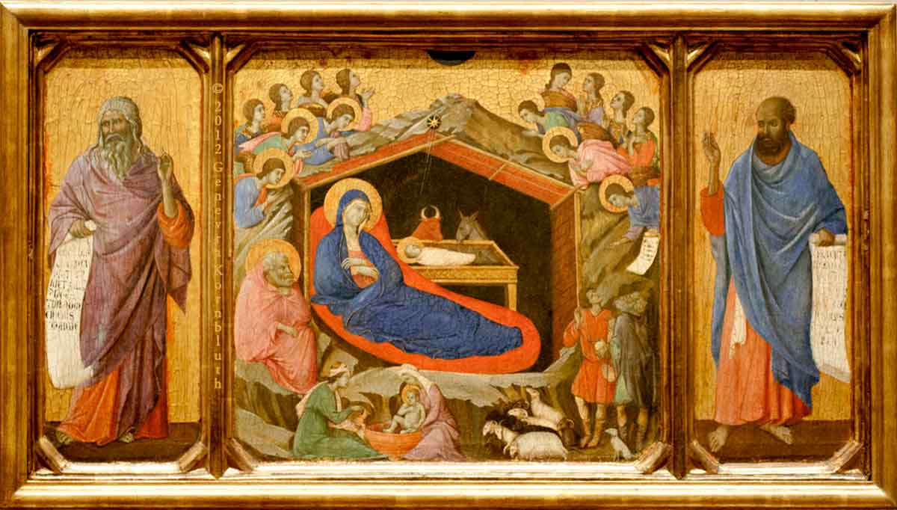
Joseph and Mary with Jesus…

Slide 7
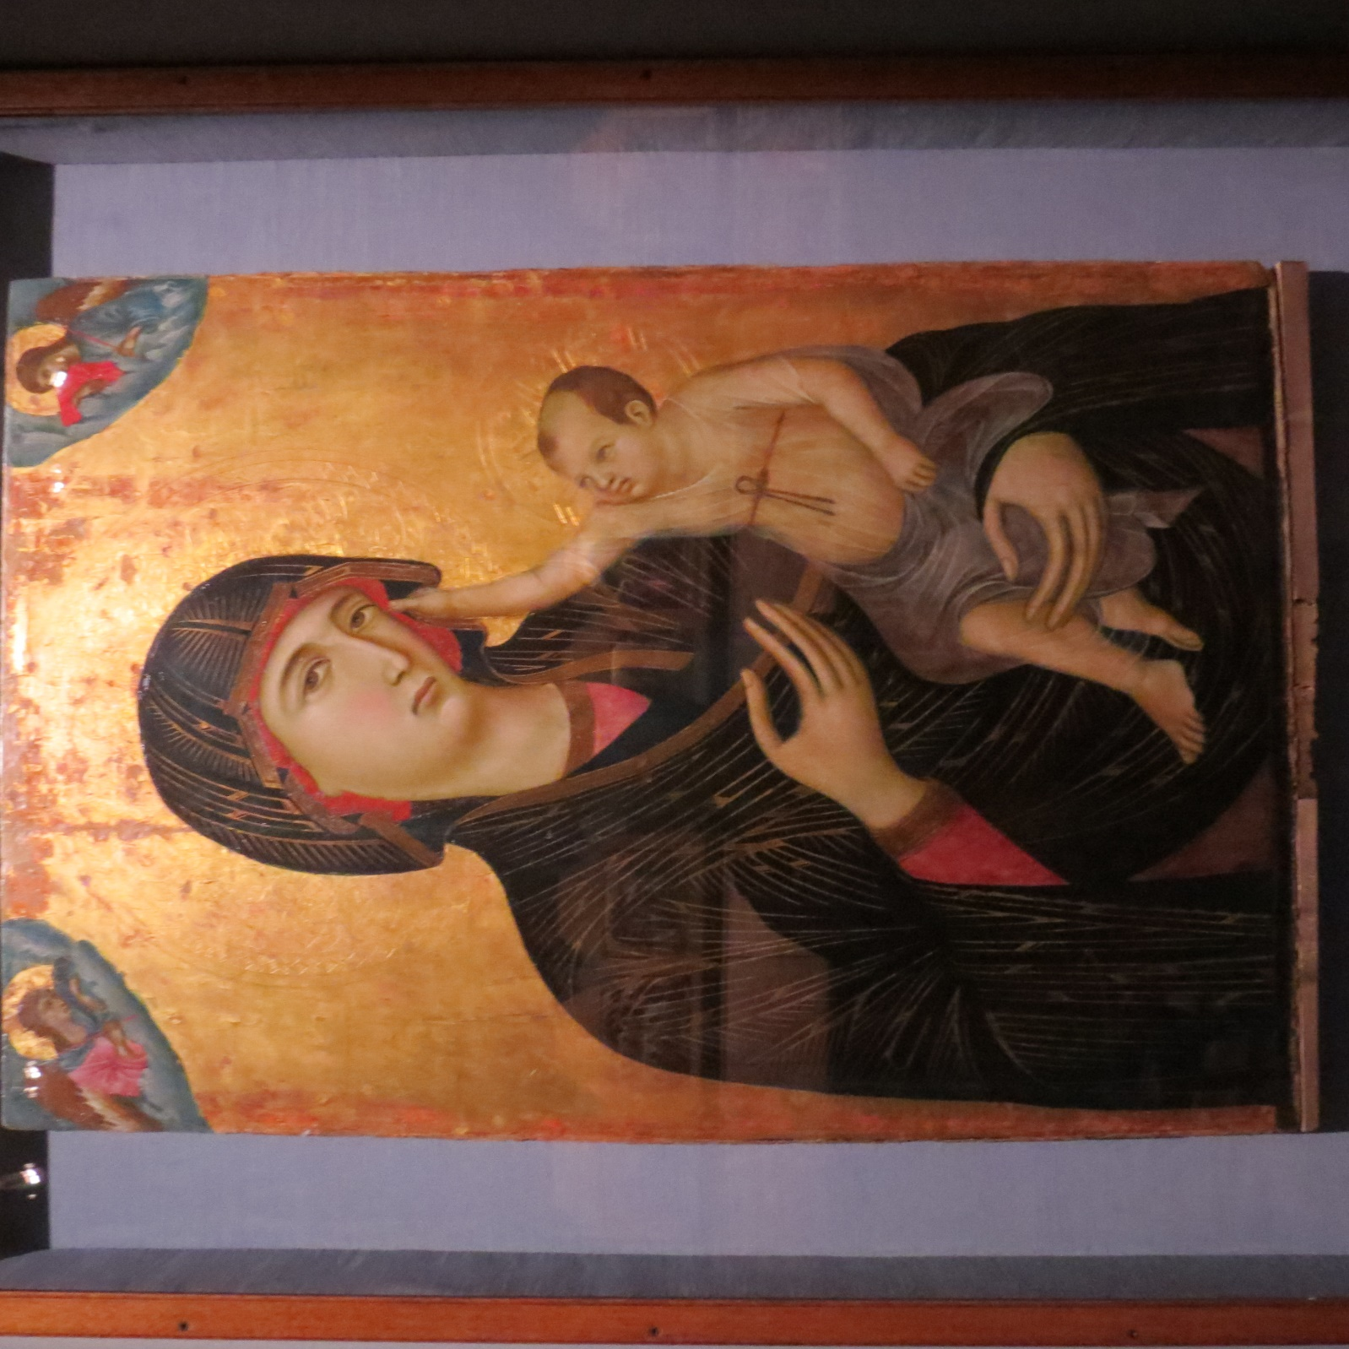
Duccio di Buoninsegna,
1283 AD, Siena, Italy

Slide 8
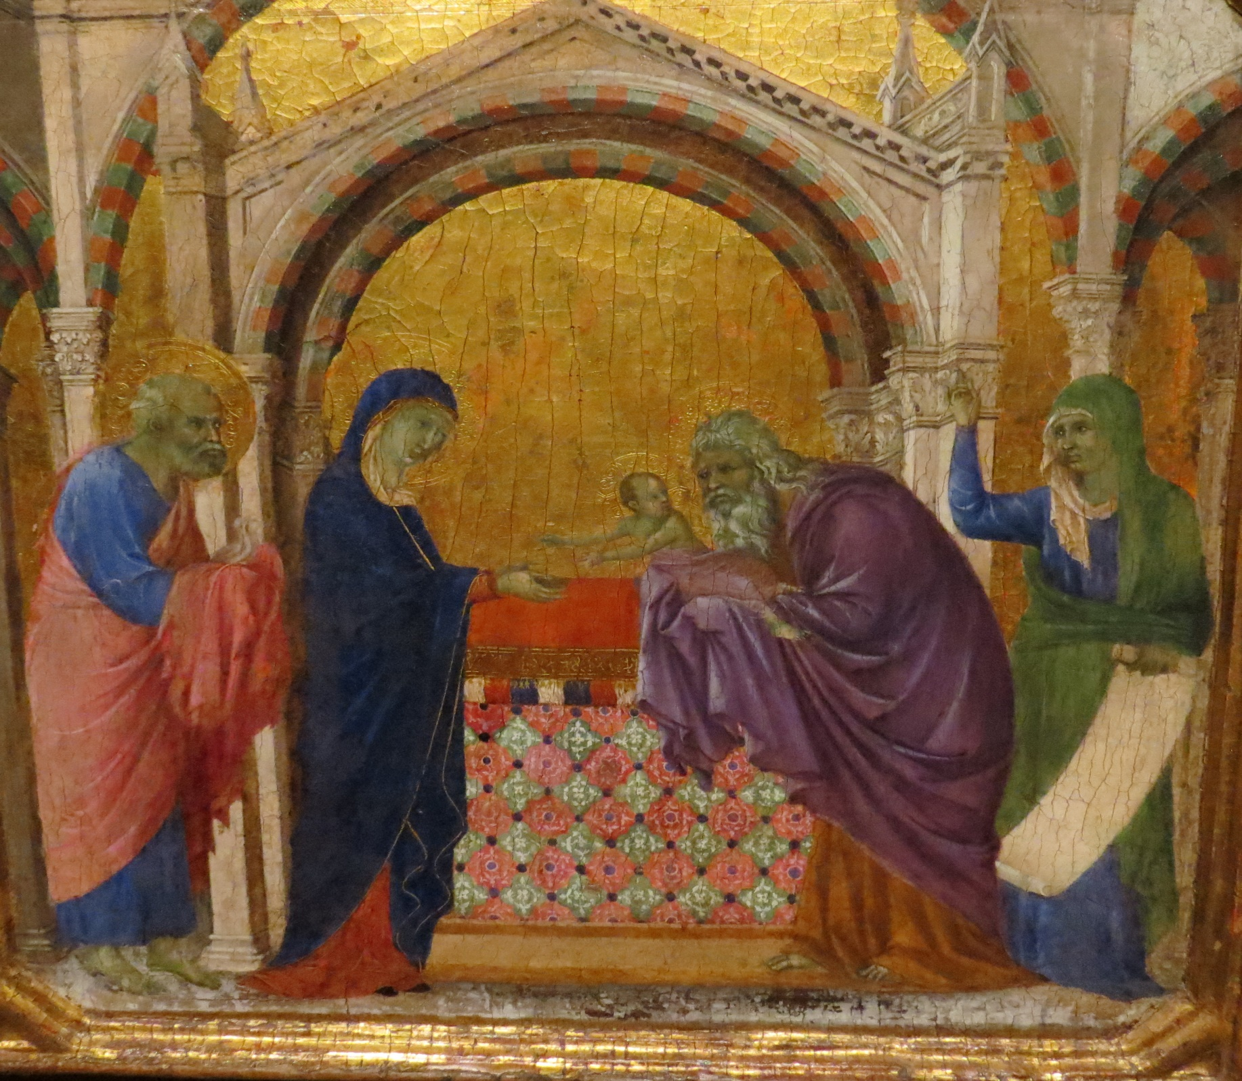
…Simeon in the Temple… the dedication of Jesus.
Matthew 2:25

Slide 9
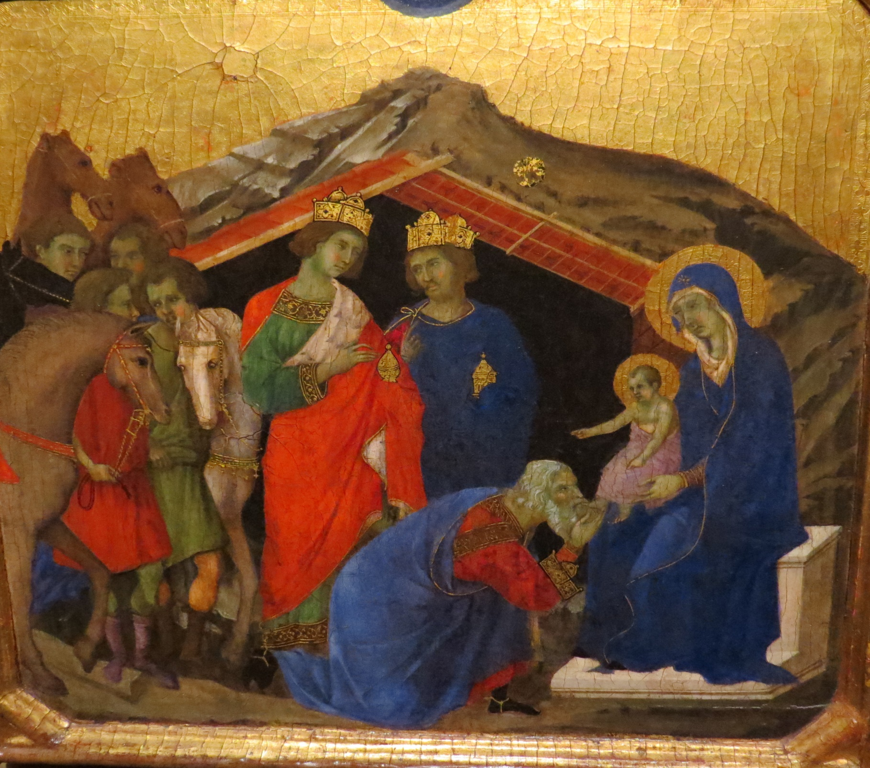
…the Wisemen giving gifts to Jesus.
Matthew 2:11

Slide 10
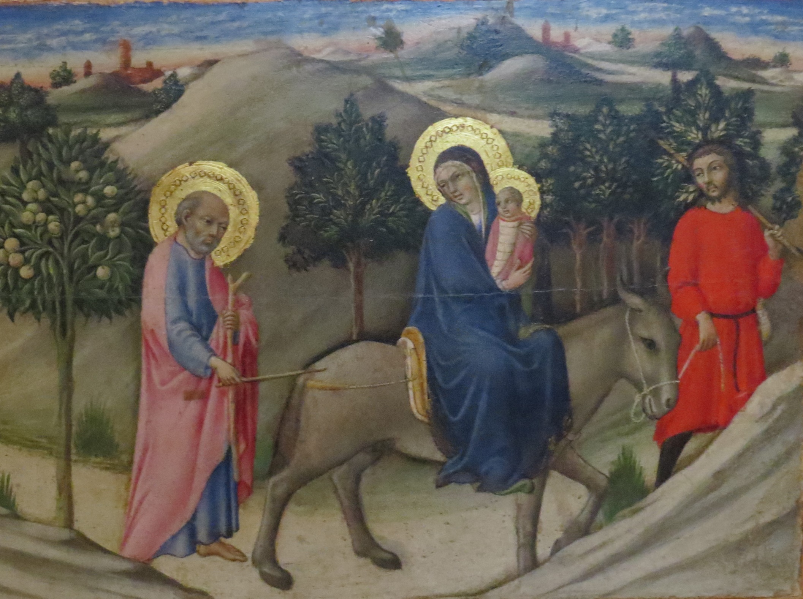
Joseph, Mary and Jesus… escape to Egypt.
Matthew 2:13

Slide 11
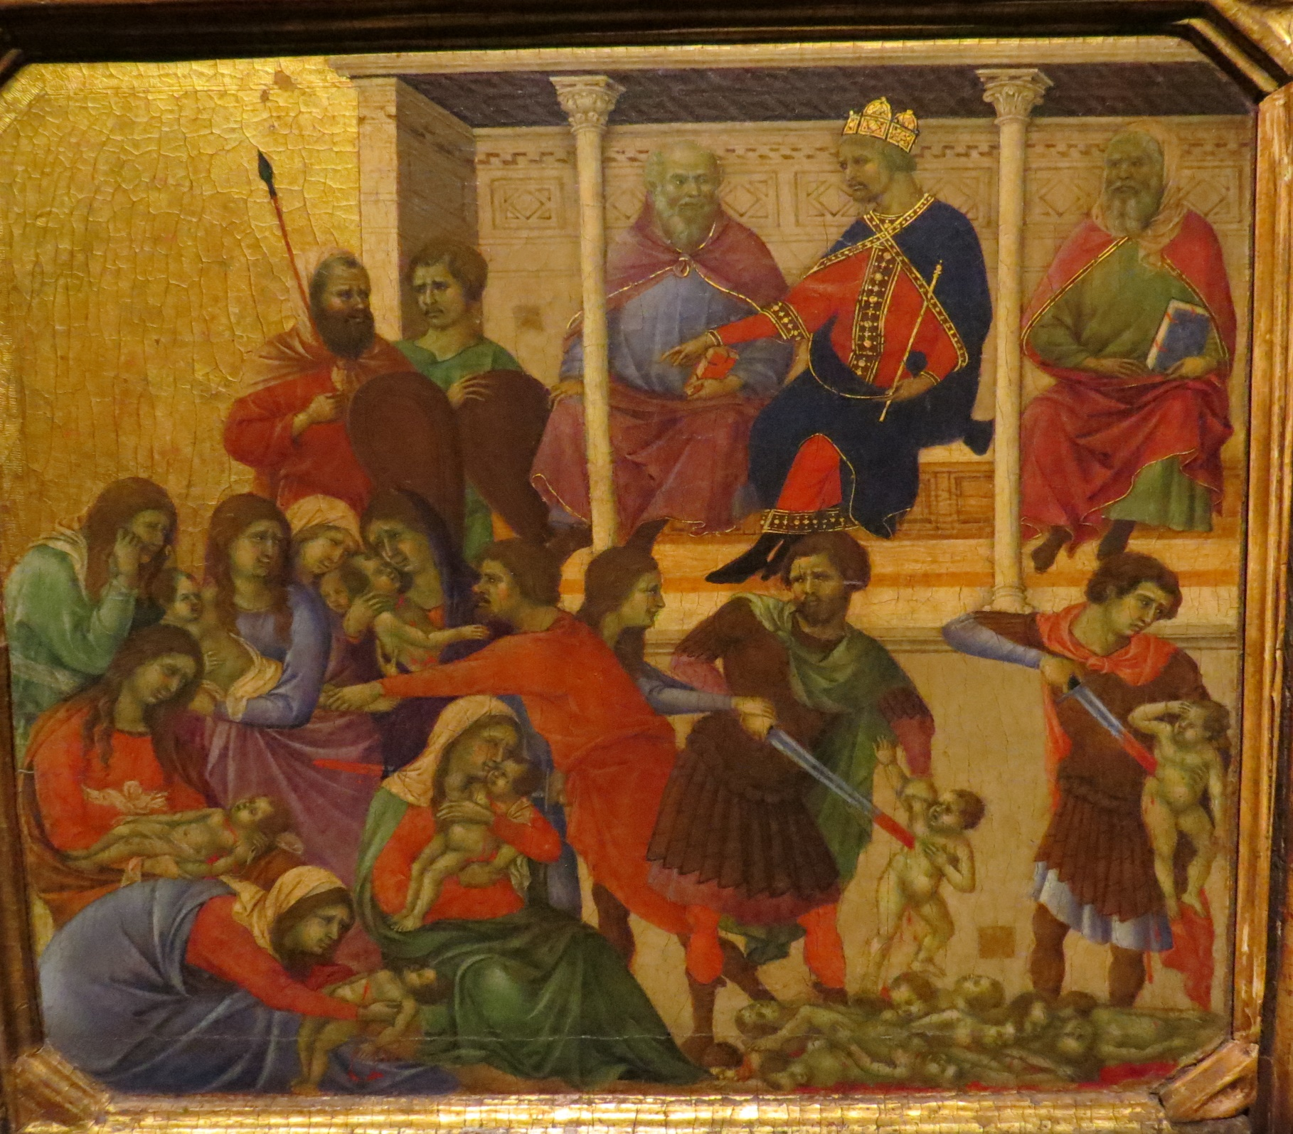
…the massacre of the innocents.
Matthew 2:16

Slide 12
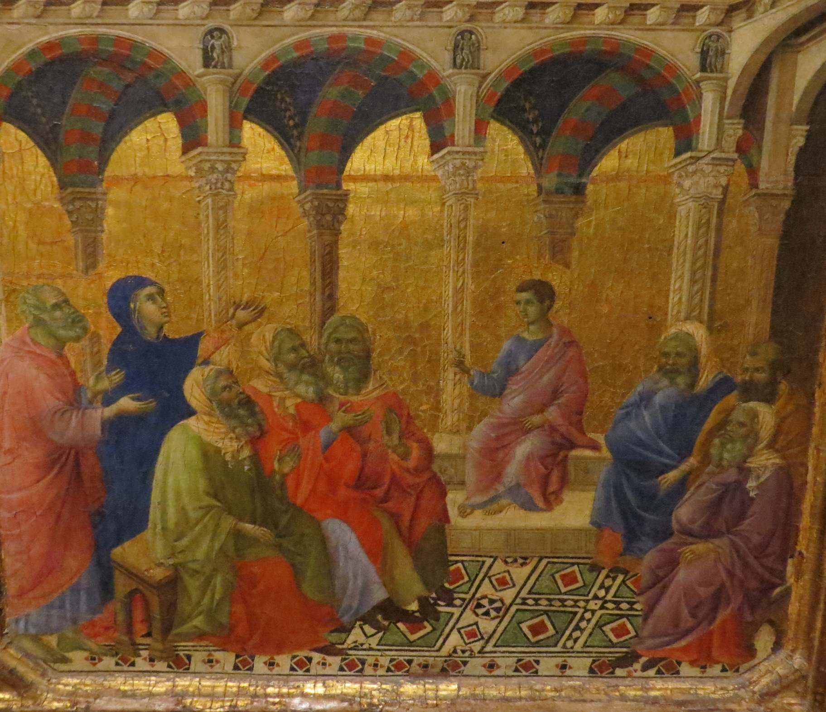
…the boy Jesus at the Temple… age 12.
Luke 2:46

Slide 13
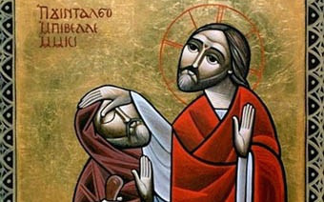
Jesus Christ…
the healer

Slide 14
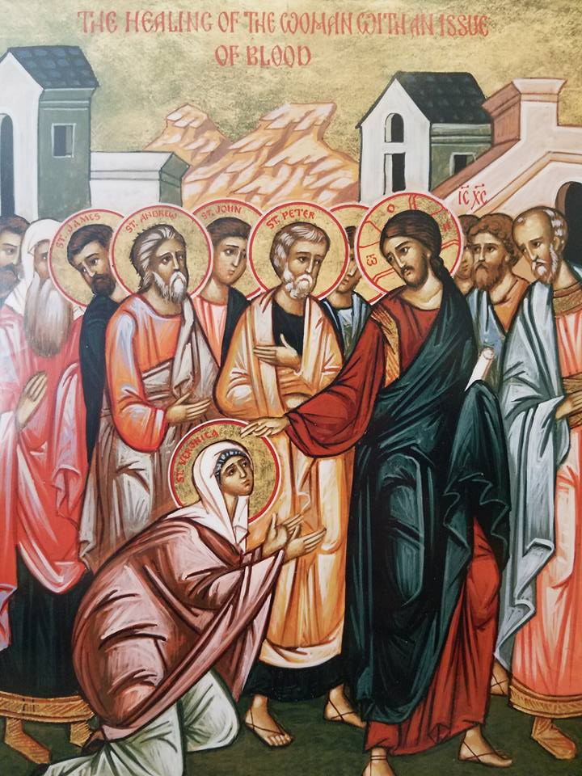
…woman with a bleeding disorder for 12 years…
Luke 8:43

Slide 15
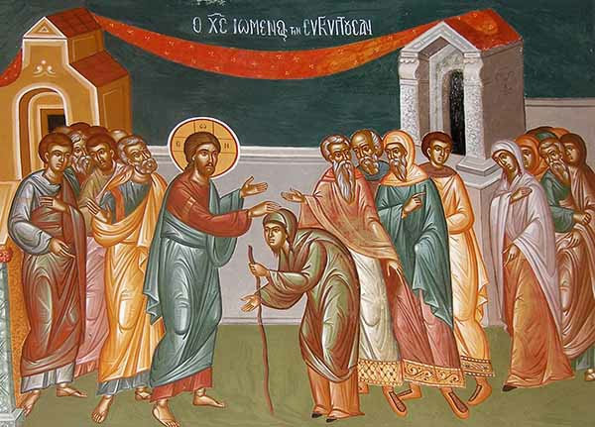
…woman who was disabled for 18 years…
Luke 13:10

Slide 16
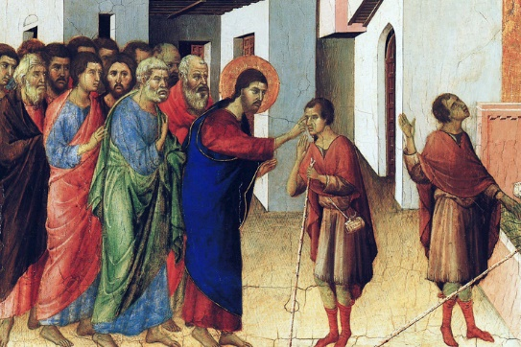
…Jesus healing the man born blind…
John 9:6

Slide 17
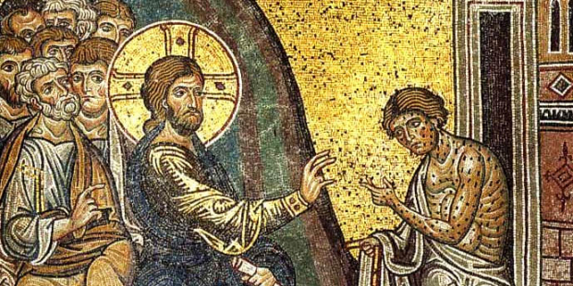
…Jesus heals a leper…
Luke 5:12

Slide 18
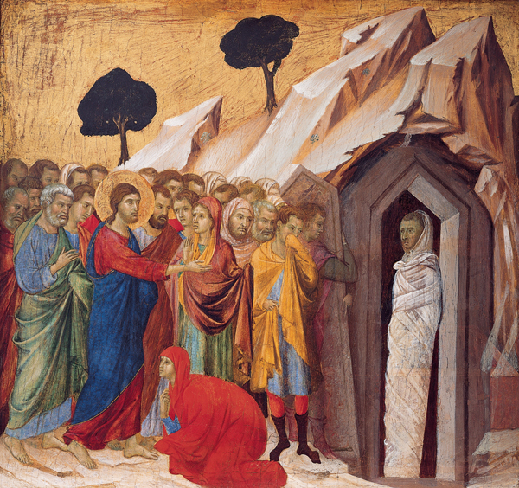
…Jesus raises Lazarus from the dead…
John 11:43

Slide 19
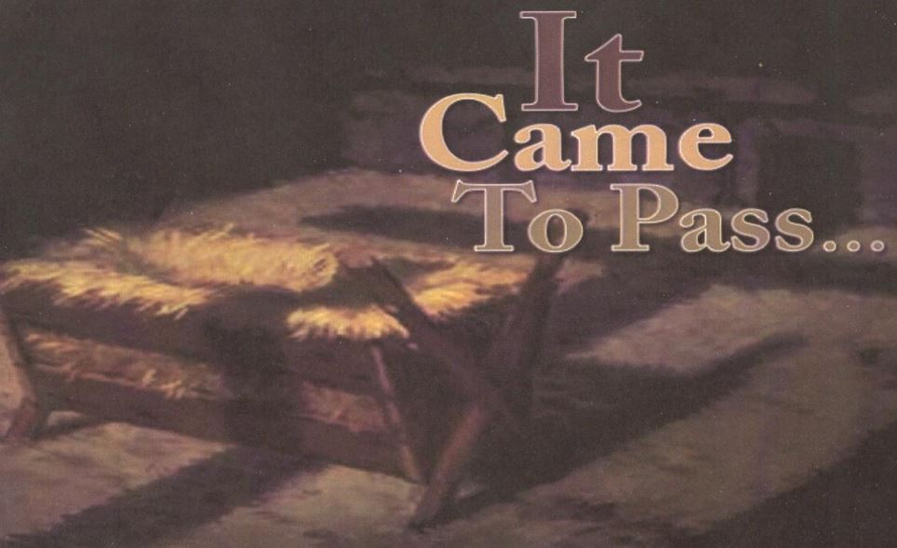

Slide 20
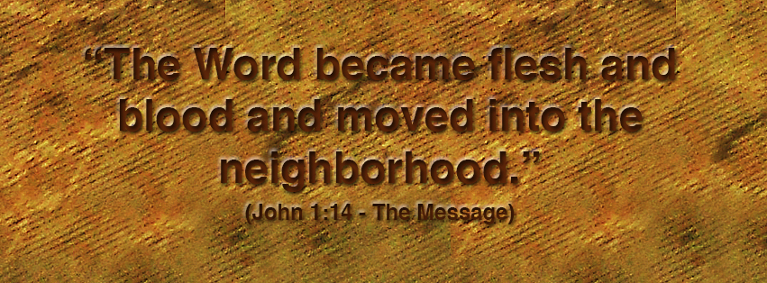

Slide 21
In dark times
In difficult times
In times determined for you
In God moments, divinely appointed

Slide 23
Responsive Reading:
Leader: How is God with us?
People: He is with us by His Spirit.
Leader: How is God incarnate today?
People: He is incarnate through us, the body of Christ.
Leader: So when someone is suffering?
People: We are His Body, showing God’s presence.

Slide 24
Responsive Reading:
Leader: When someone has no voice?
People: We are His Body, God’s listening ear.
Leader: When someone needs to cry?
People: We are His Body, God’s arms of love.
Leader: When someone needs a meal?
People: We are His Body, God’s hands to serve.

Slide 25
Responsive Reading:
Leader: Go then into God’s world and show His love.
People: We will go and we will love.
Leader: See the ones that Jesus will show you.
People: We will see them and we will love.
Leader: Remember that Jesus goes with you.
People: We will remember, for we are the Body of Christ, God with skin on.

