Slide 3
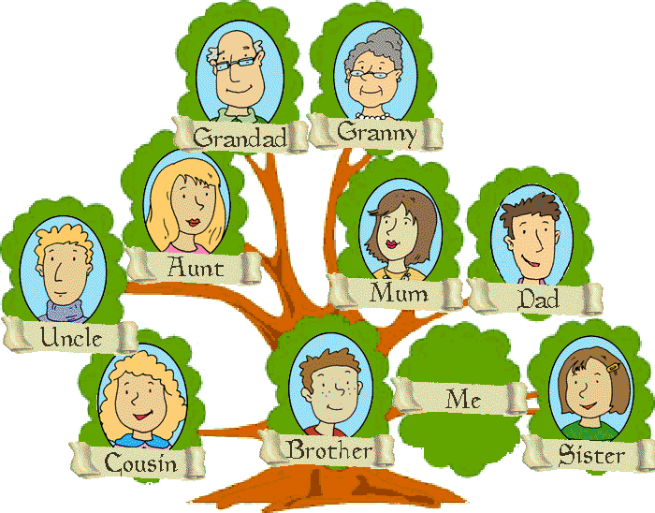

Slide 4
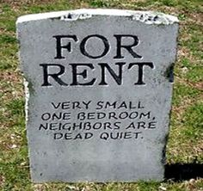

Slide 5
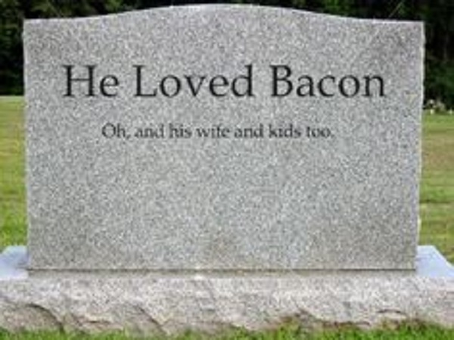

Slide 7
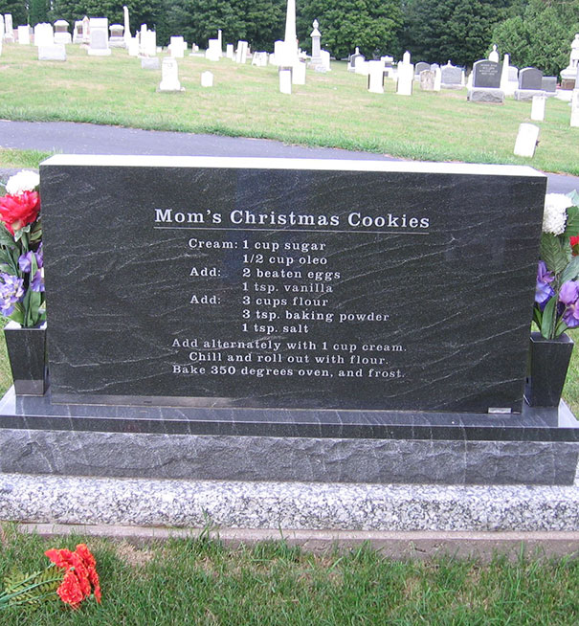

Slide 8
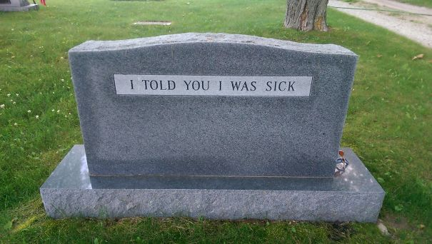

Slide 9
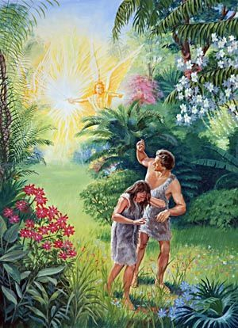
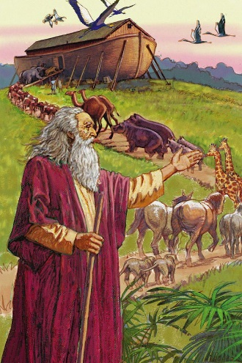
From Adam to Noah

Slide 10
- The Generations of Adam through Cain (Gen. 4:17 – 24 - The Generations of Adam through Seth (Gen. 4:25 – 5:32) - The Degeneration of Humanity through Sin (Gen. 6:1 – 8)

Slide 14
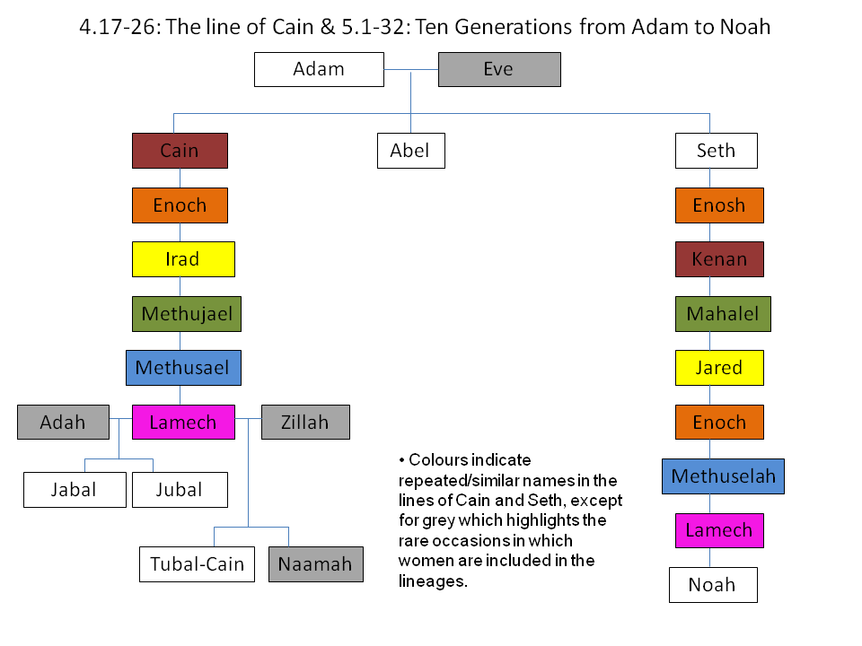

Slide 15
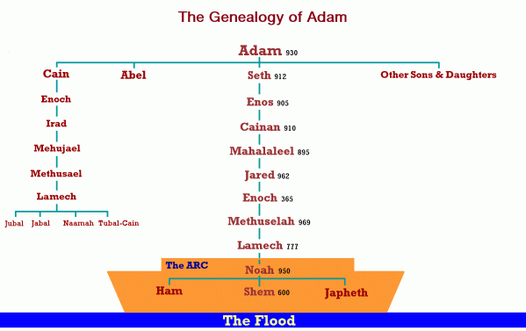

Slide 16
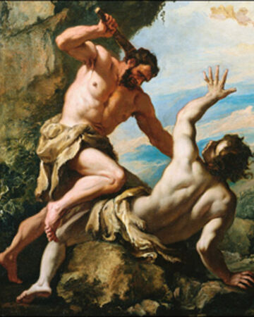
Cain gave an offering unacceptable to God
Cain ignored God’s warning about sin
Cain became jealous, angry and sullen
Cain rose up and killed his brother Abel
Cain was judged by God as a fugitive / wanderer
Cain was sent away from the presence of the Lord

Slide 18
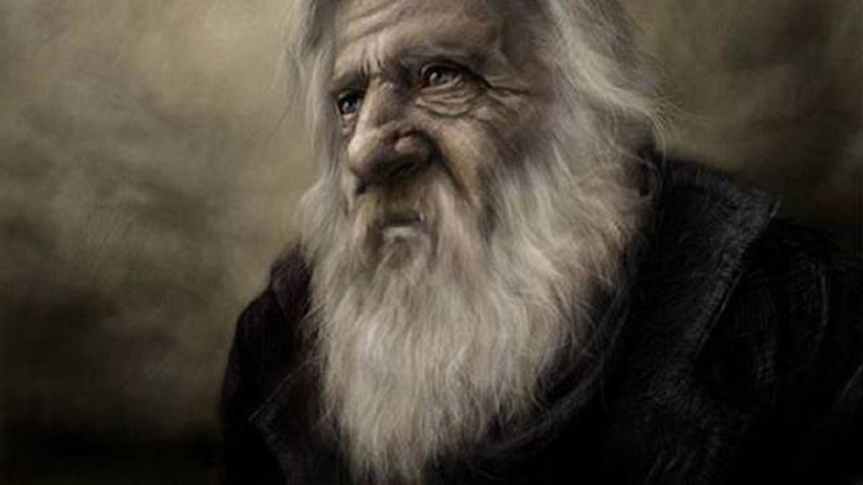
What does the Bible tell us about Lamech?
He was the first Polygamist (4:19)
He was a murderer like Cain (4:23)
He was arrogant / unrepentant (4:24)

Slide 19
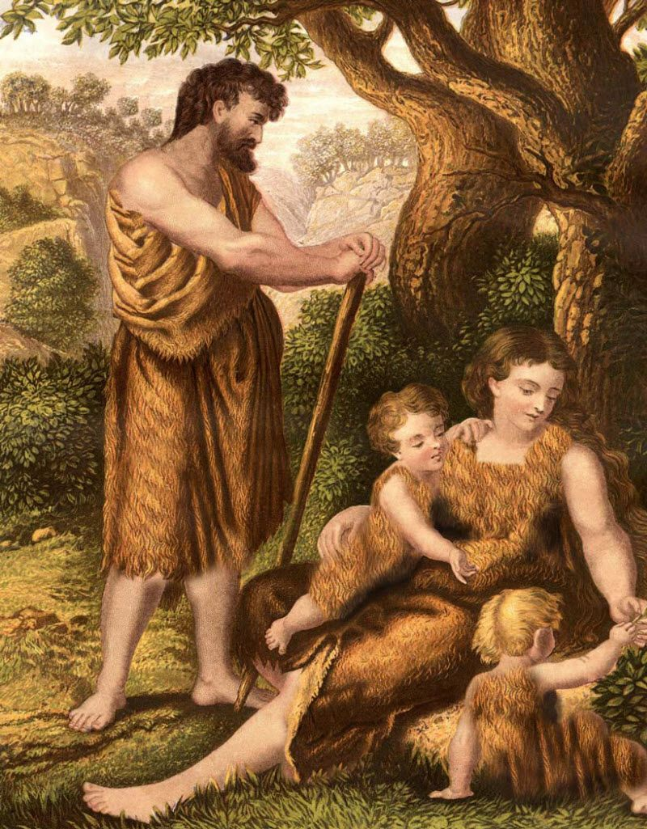
- God has appointed for me another son to replace Abel. – Genesis 4:25
- At that time people began to call upon the Name of the Lord. (vs. 26)

Slide 21
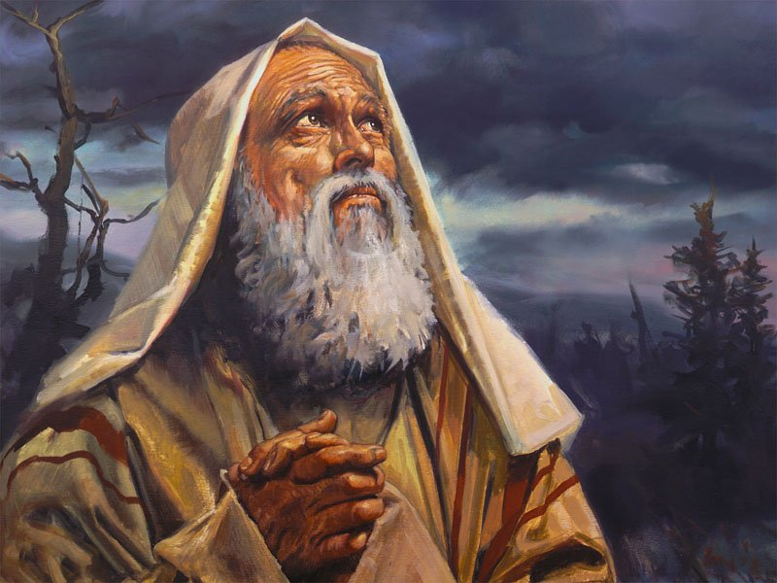
Enoch walked with God, and he was not, for God took him. – Genesis 5:24

Slide 22
By faith Enoch was taken up so that he should not see death, and he was not found, because God had taken him. Now before he was taken he was commended as having pleased God. – Hebrews 11:5

Slide 23
. And without faith it is impossible to please Him, for whoever would draw near to God must believe that He exists and that He rewards those who seek Him. – Hebrews 11:6

Slide 24
