Slide 3
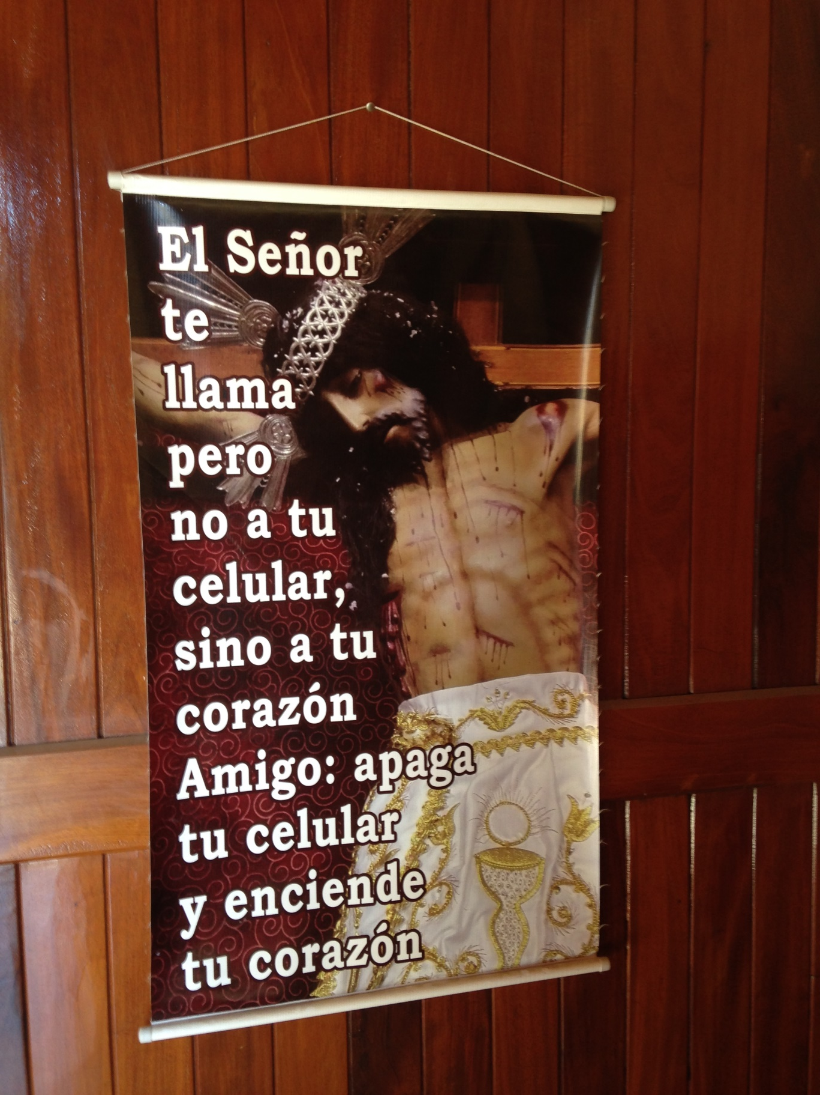

Slide 4
The Lord is calling you, not on your cell phone but rather on your heart.
Friend, shut off your cell phone and turn on your heart.

Slide 5
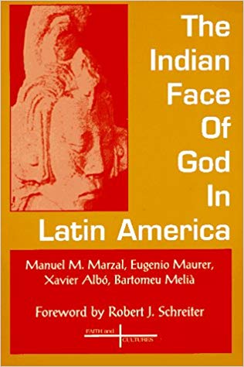
The penetration of the gospel must take into account: Home – family relationships make survival possible. Agriculture – a social effort of planting and harvesting. Community – including ancestral awareness. Poor and Needy – social net created by community. Festivals – an experience of their view of god expressed in dance, costume, food and drink. Crisis – from funerals to droughts to other disasters… Struggle for Rights – factor which unites all Indigenous people around the globe.

Slide 6
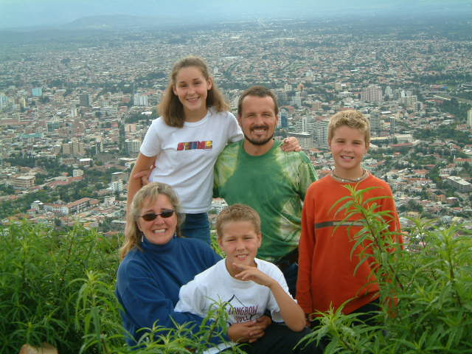
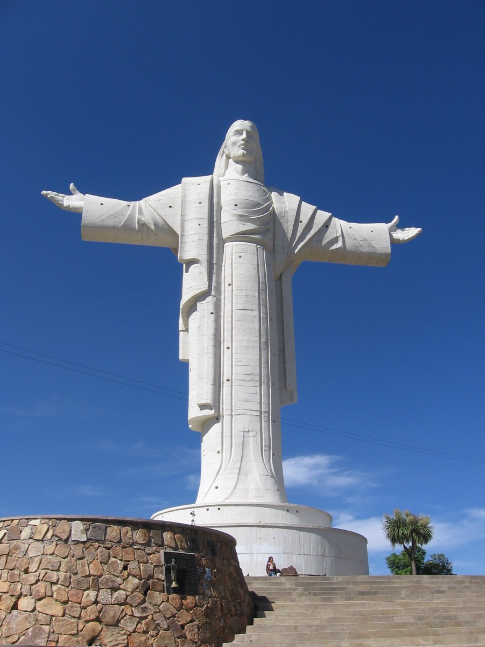

Slide 7
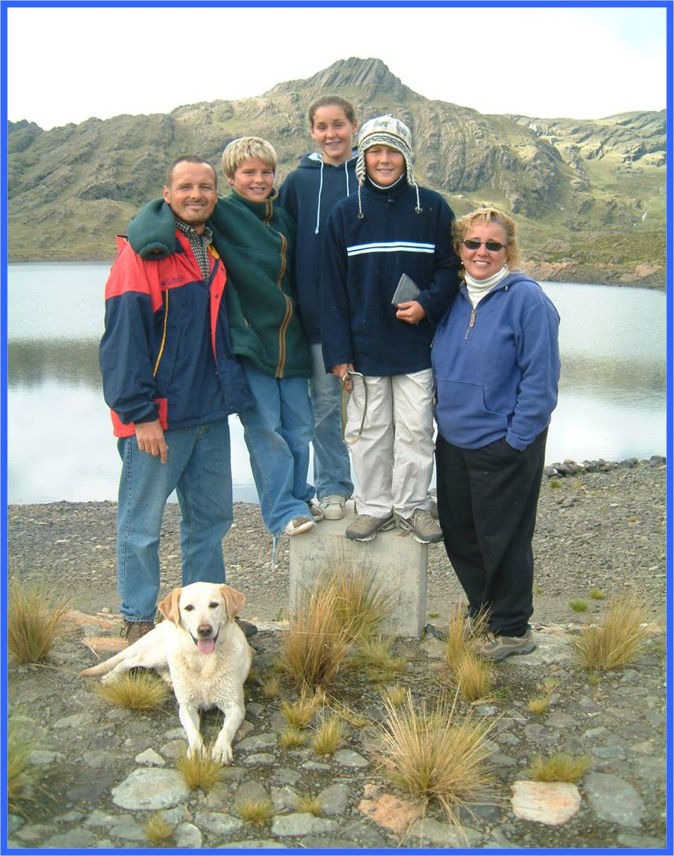
Call to Missions:
Go to the land that I will show you… Genesis 12:1
And he went, not knowing where he was going…
Hebrew 11:8

Slide 8
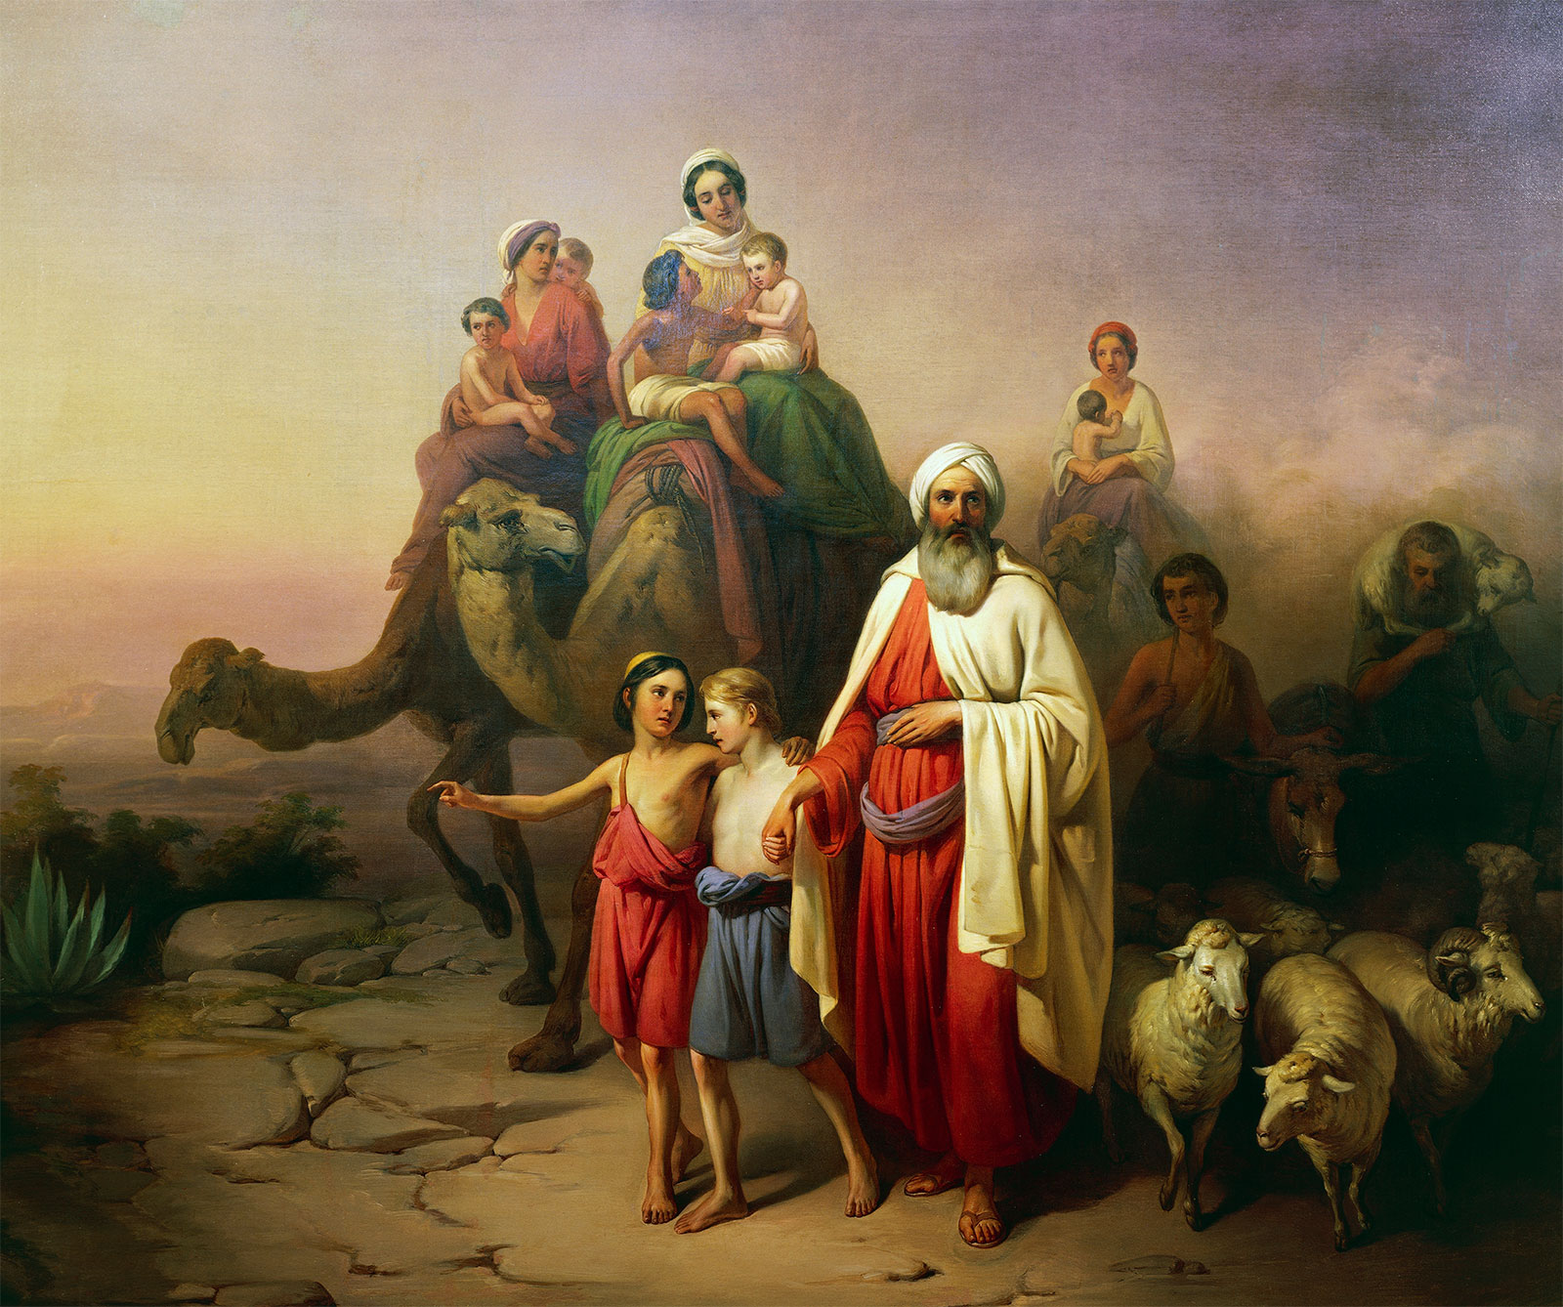
Go to the land that I will show you… Genesis 12:1
And he went, not knowing where he was going…
Hebrew 11:8

Slide 9
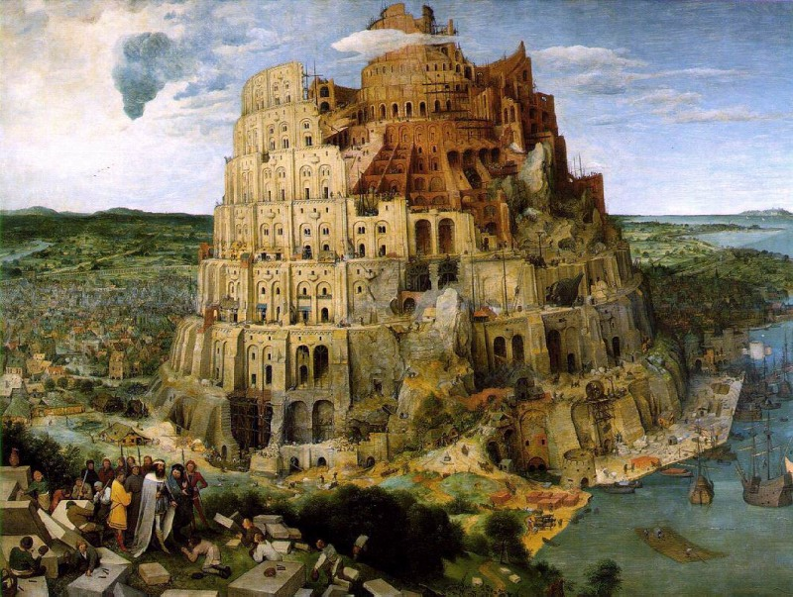
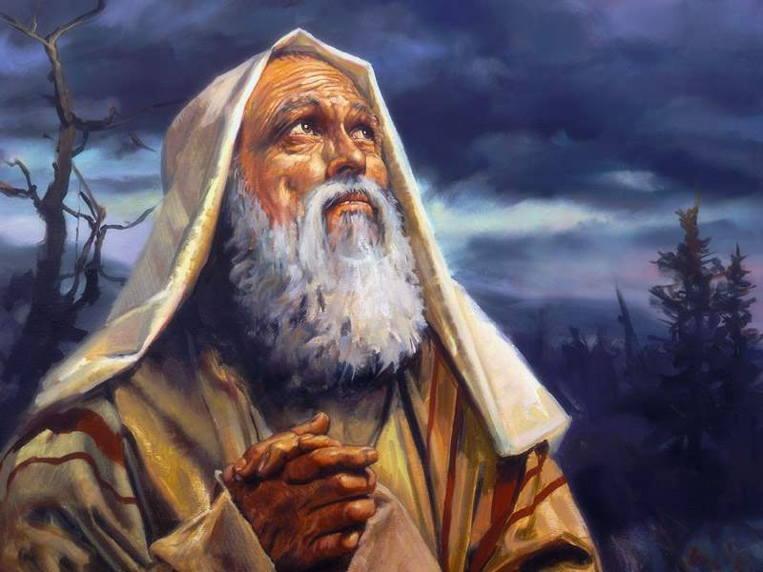
From the Tower of Babel…
To Abraham

Slide 10
Scripture Lesson:
Genesis 12:1 – 3
Psalm 67:1 – 2
Habakkuk 2:14
Matthew 28:19
Acts 1:8
Revelation 7:9 - 10

Slide 11
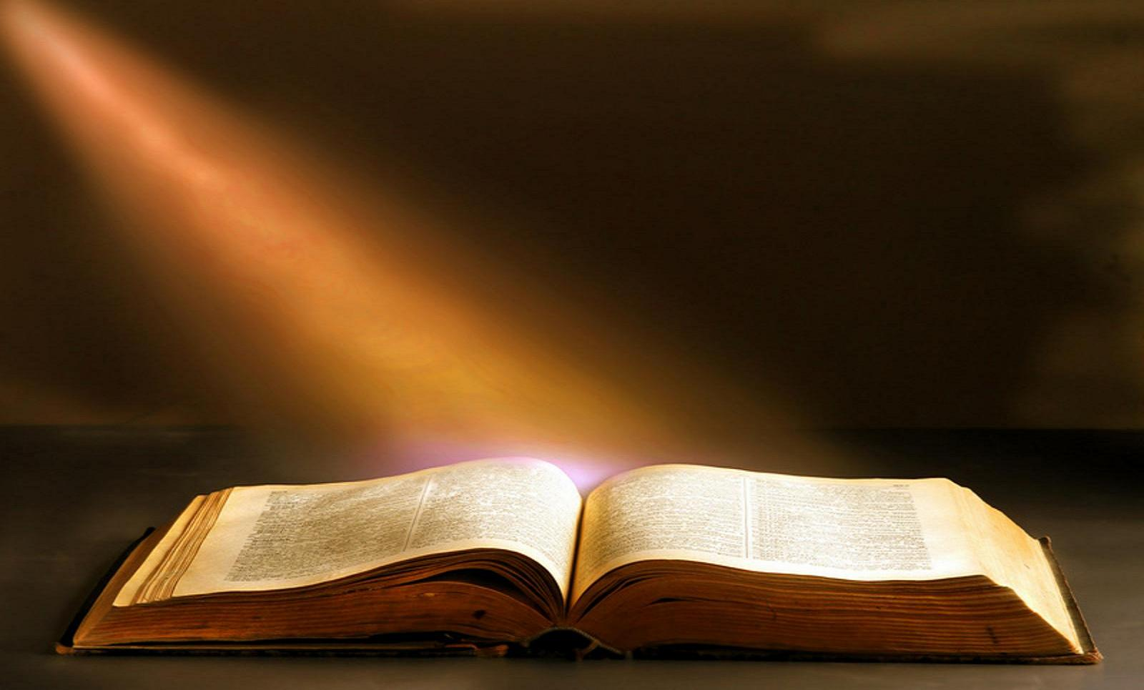
Genesis and Revelation serve like book ends of the Bible.

Slide 12
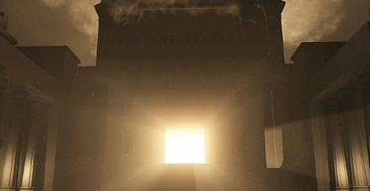
The Bible begins and ends with a temple; God being known and dwelling with His people.

Slide 13
The Bible begins and ends with the tree of life.

Slide 14
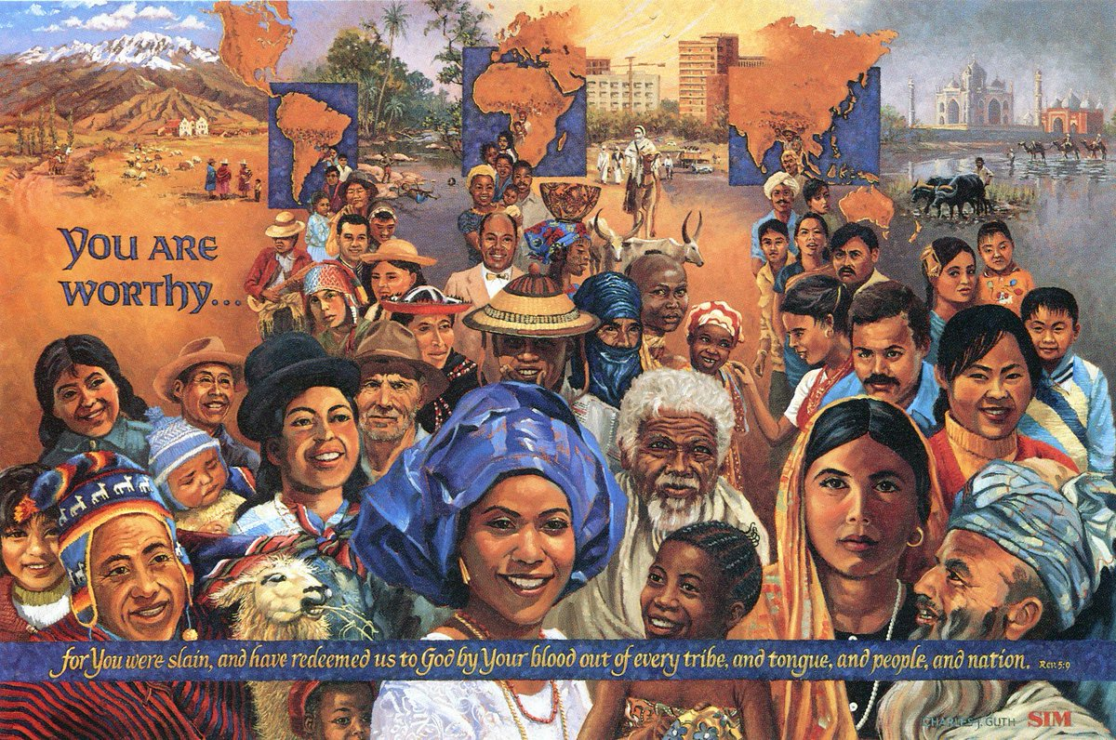
The Bible begins and ends with a global call.

Slide 15
The root system of the Church can be traced back to Abraham because God’s promise was to make him into a great nation.

Slide 16
That nation became Israel and the Messiah of Israel became Jesus Christ.

Slide 17
Jesus Christ is of the seed of Abraham, who is the seed of the Church.

Slide 18
In Jesus Christ God has called together one people for His glory, the Church, made up of both Jews and Gentiles.

Slide 19
We see the fulfillment of the covenant with Abraham in the Book of Revelation when people from every tribe and language and nation are worshipping the Lamb of God.

Slide 21
“Worship is also an act of rehearsal. It is an anticipation of things to come. It is the moment at which we are reminded that our lives and our world have a goal, and that this goal is that day when every nation and tribe and people and language will worship God and the Lamb. Justo Gonzalez, For the Healing of the Nations

Slide 22
“
Missions is not the ultimate goal of the church. Worship is. Missions exists because worship doesn’t. Worship is ultimate, not missions, because God is ultimate, not man. When this age is over, and the countless millions of the redeemed fall on their faces before the throne of God, missions will be no more...but worship abides forever.
John Piper, Let the Nations be Glad

Slide 23
“
Blessed… to be a blessing!

Slide 24
“
Responding in Faith to God’s Call on your life:
Means leaving something behind (12:1)
Brings greater blessing than you could achieve for yourself (11:4)
Makes your life a blessing to others; especially those different than you (12:2 – 9)

Slide 25
The word of the Lord came to me saying, ’Before I formed you in the womb I knew you, before you were born I set you apart. I appointed you as a prophet to the nations.’ - Jeremiah 1:5
But by the grace of God I am what I am, and His grace to me was not without effect. Instead, I worked harder than all of them – yet not I, but the grace of God that was with me. - 1 Corinthians 15:10

Slide 26
“

Slide 27
“

Slide 28
“

