Slide 4
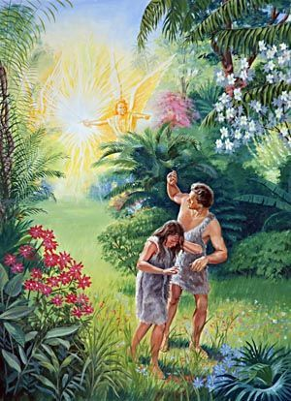
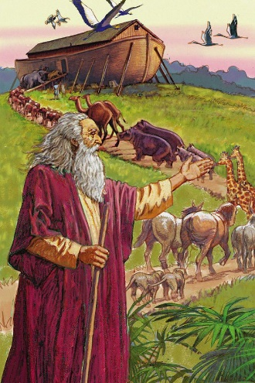
From Adam to Noah

Slide 5
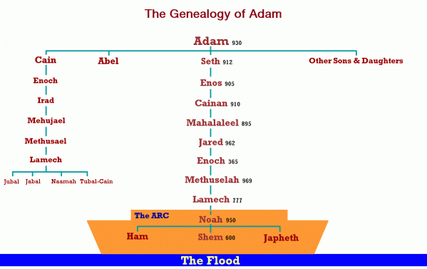

Slide 6
The downward slide of morality
The preservation of the faithful

Slide 7
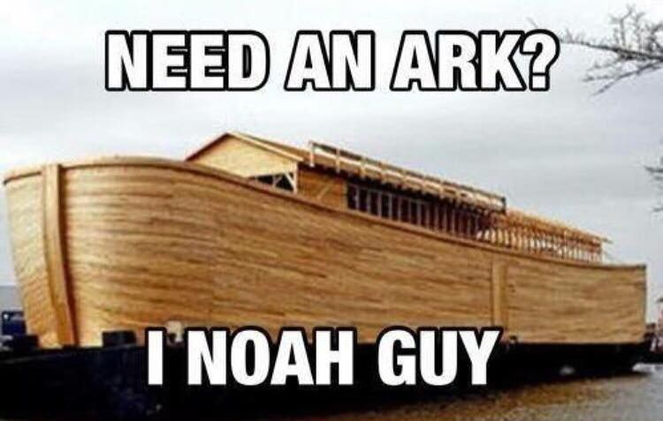

Slide 8
The Flood that Destroyed the World

Slide 9
The Flood that Changed the World

Slide 10
The Flood that Saved the World

Slide 11
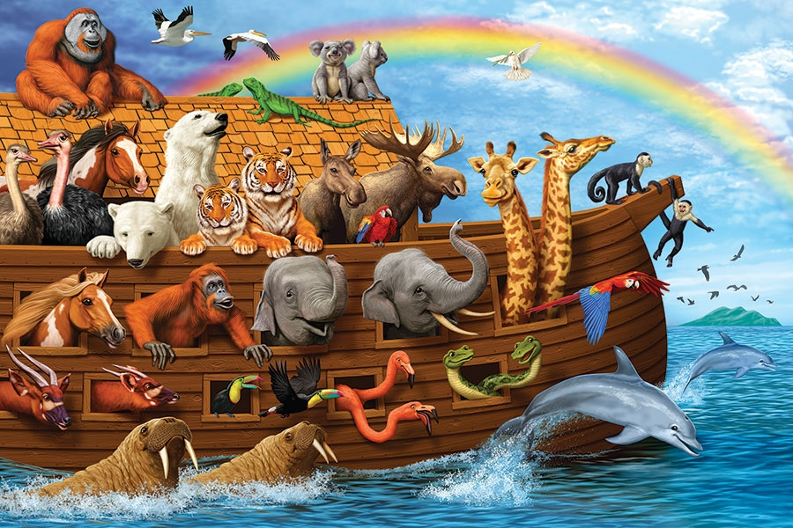

Slide 12
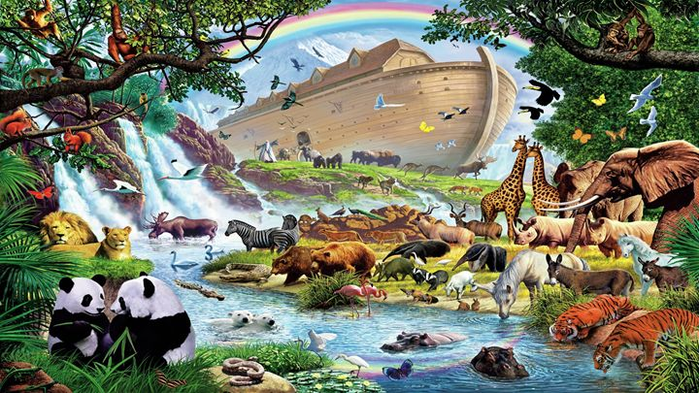

Slide 13
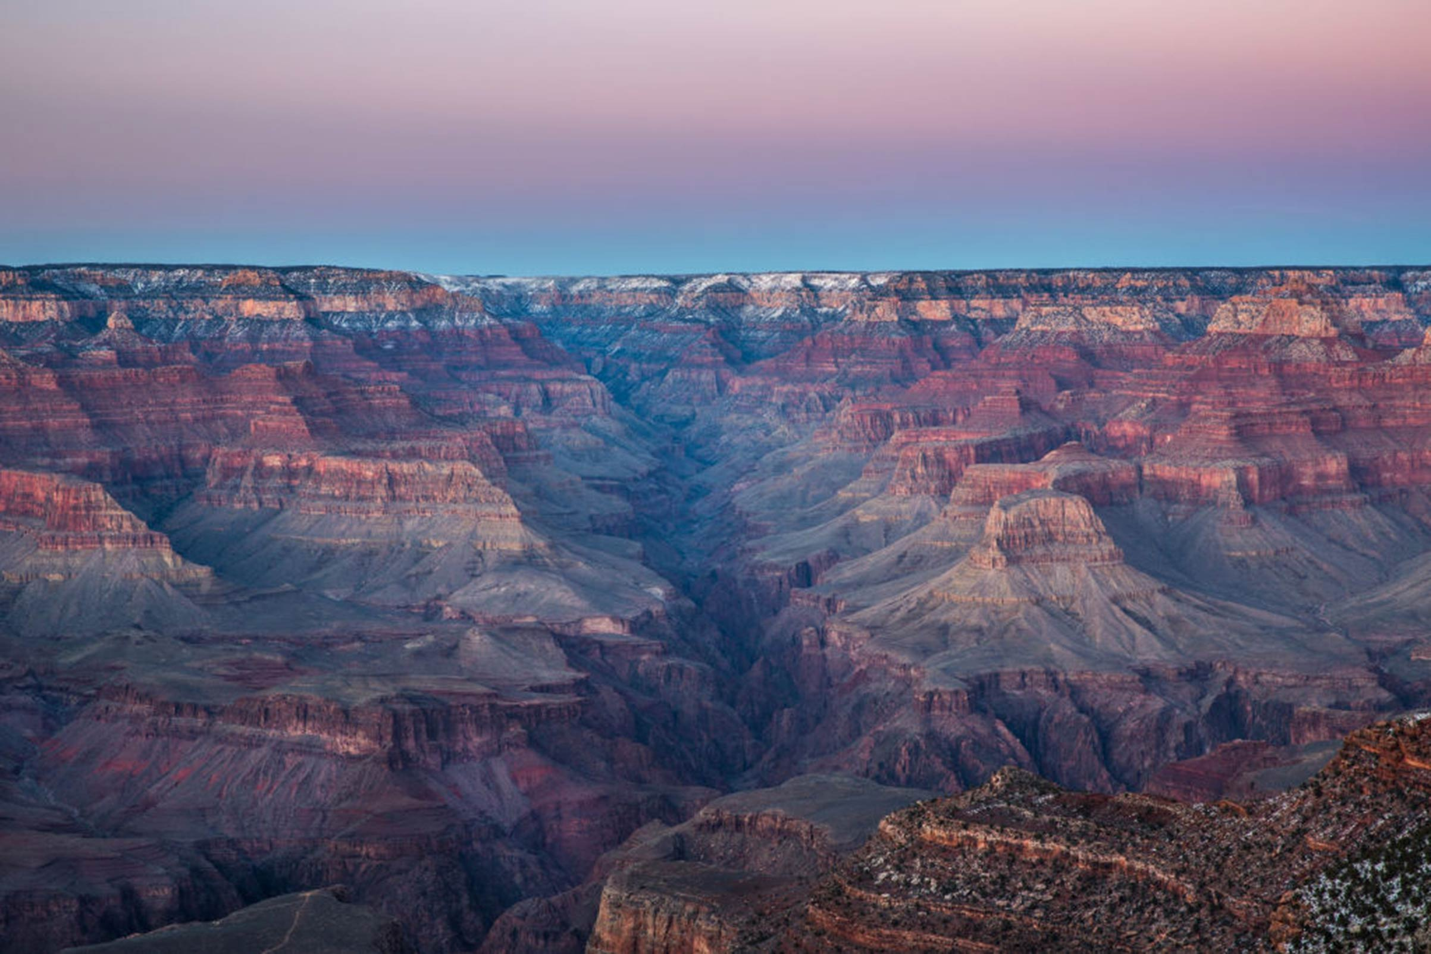

Slide 14
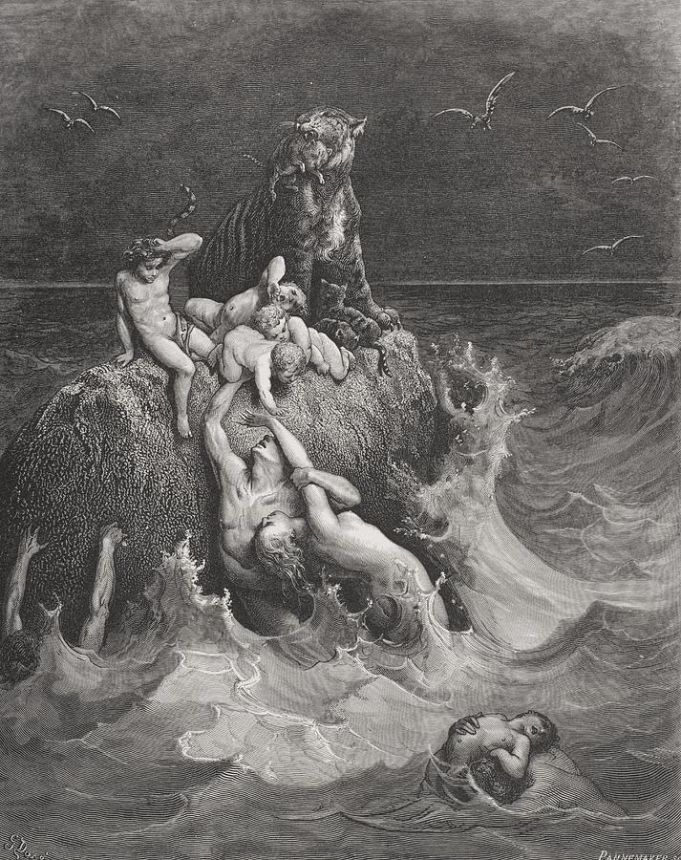
The Deluge,
By Gustave Dore (1832 – 1883)

Slide 15
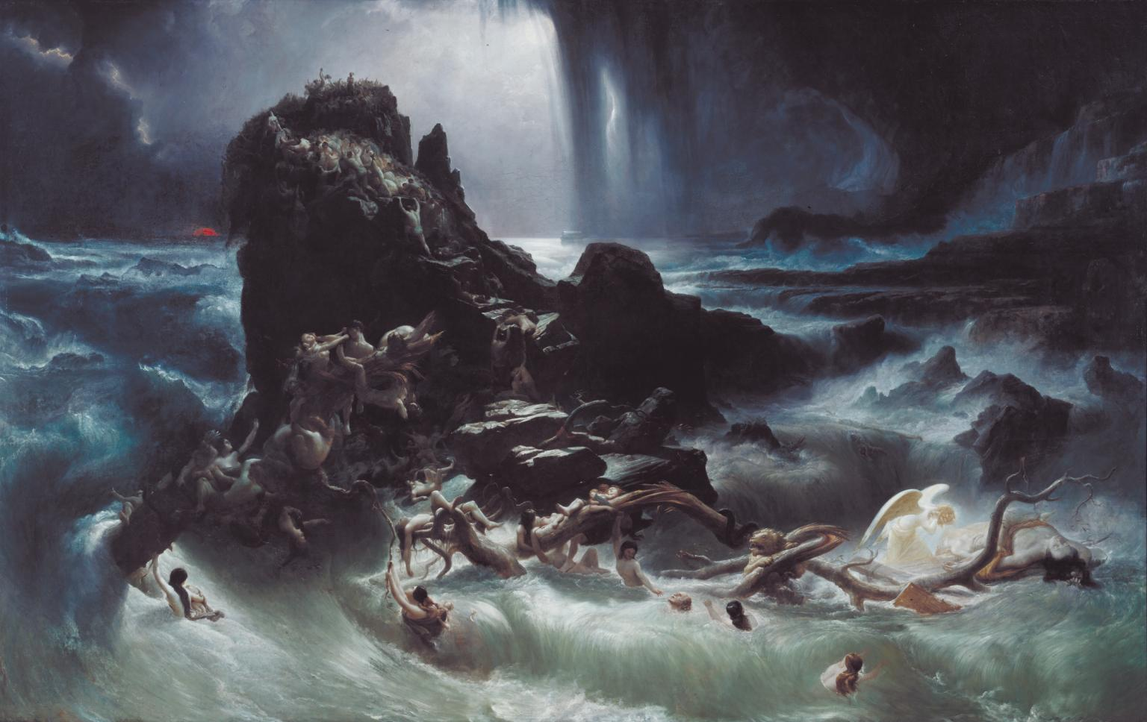

Slide 16
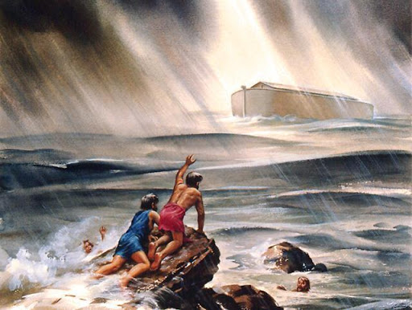

Slide 17
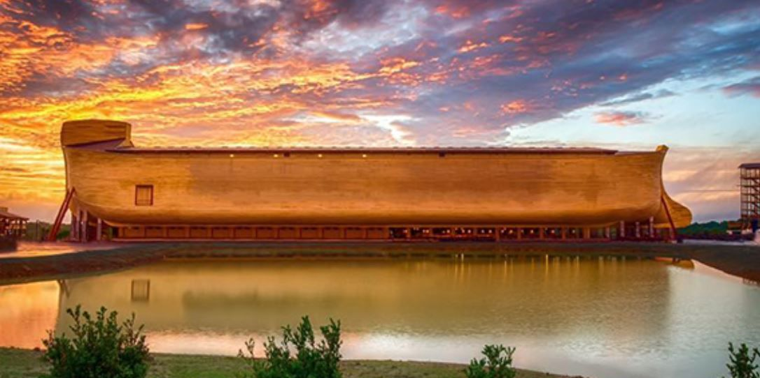

Slide 18
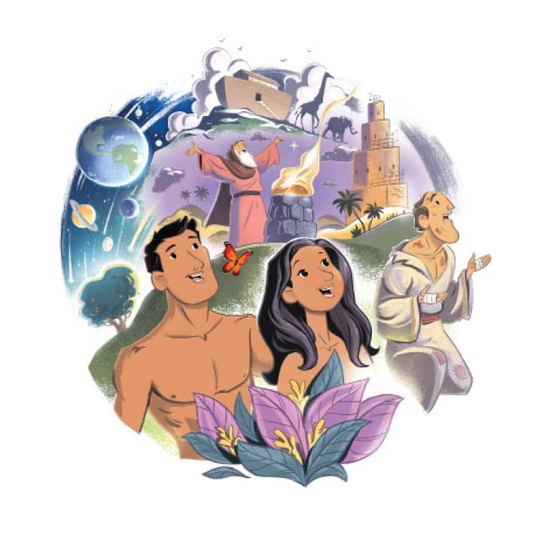

Slide 19
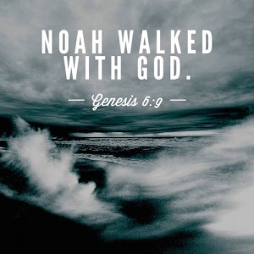
Scripture Reading: Genesis 6:9 – 22

Slide 20
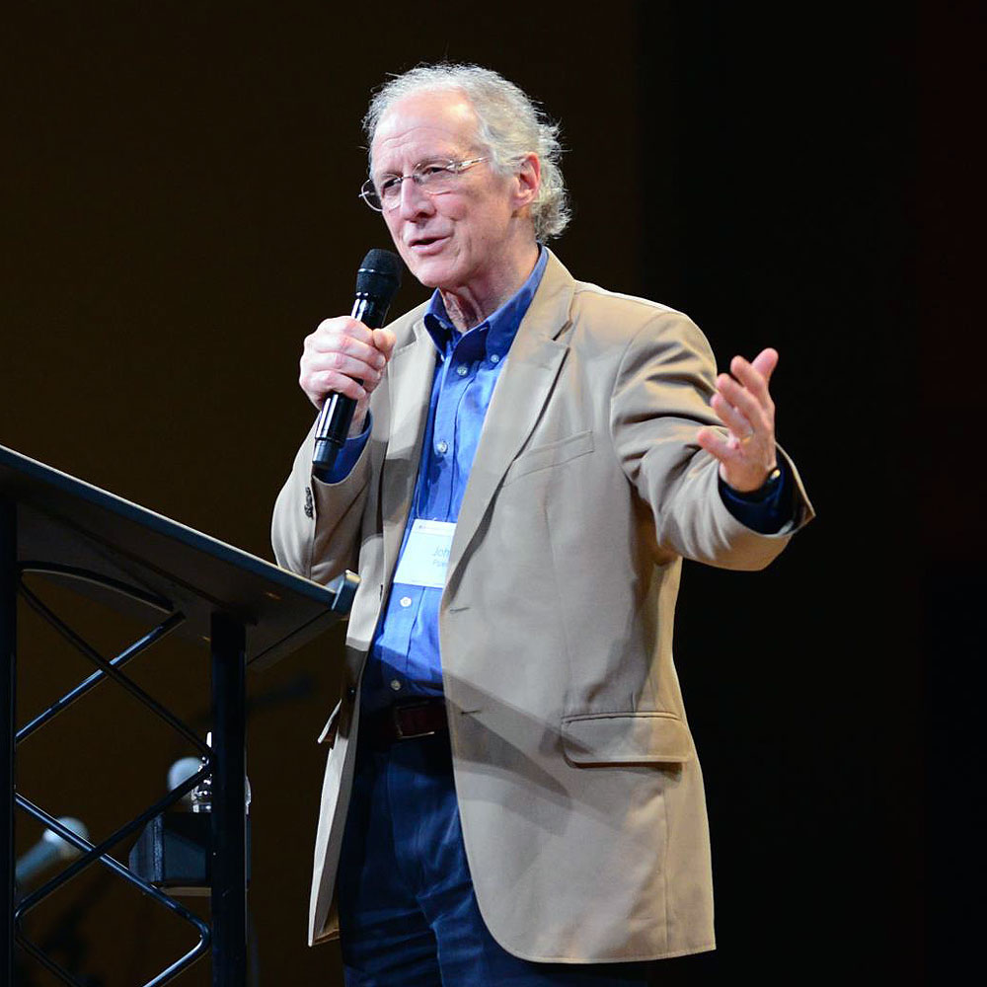
If you don't believe in a God who is powerfully involved in history, then the only explanation of events you will look for are past causes, not future purposes. But as soon as you reckon with the God of the Bible, tomorrow will always be part of today's explanation.
- John Piper

Slide 21
Noah:
The Son of Adam who walked with God
The Father of Moses who was saved by God
The Preacher of righteousness used by God

Slide 23
Noah found favour in the eyes of the Lord (6:8)
Noah was a righteous man (6:9)
Noah was blameless in his generation (6:9)
Noah walked with God (6:9)
Noah did all that God commanded (6:22; 7:5)

Slide 24
Noah is depicted as Adam revived. He is the sole survivor and successor to Adam; both walk with God; both are recipients of the promissory blessing; both are care-takers of the lower creatures; both father three sons; both are workers of the soil; both sin through the fruit of a tree; and both father a wicked son who is under a curse.
- Kenneth A. Matthews

Slide 25
Noah:
The Son of Adam who walked with God
The Father of Moses who was saved by God

Slide 26
Both Noah and Moses were:
Care-takers of a Covenant with God
Placed in an Ark to save them from death.
Delivered from water by the grace of God
Begin a new era of God’s relationship to people
Given detailed instructions and obeyed God
Mediators with God’s people through sacrifice.

Slide 27
Noah:
The Son of Adam who walked with God
The Father of Moses who was saved by God
The Preacher of righteousness used by God

Slide 28
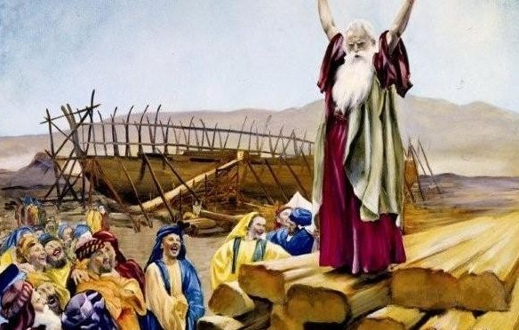
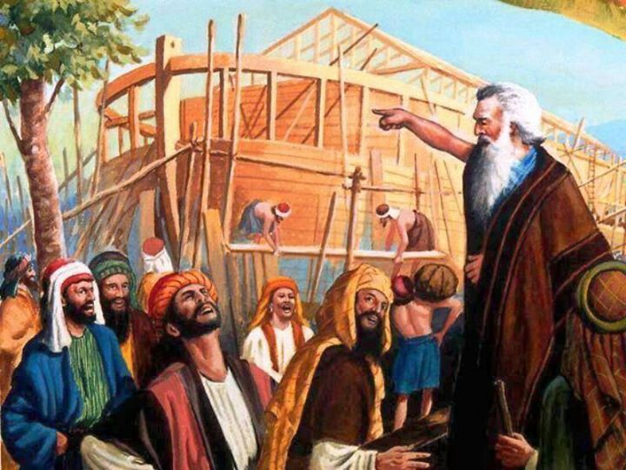
Noah, a preacher of Righteousness
2 Peter 2:5

Slide 29
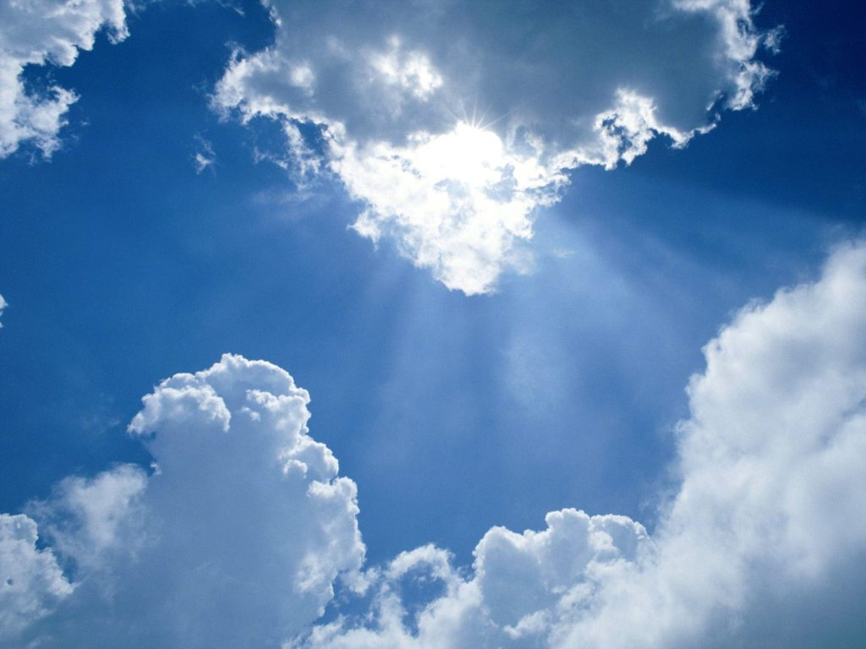
Just as it was in the days of Noah, so shall it be at the coming of the Son of Man
Luke 17:26

Slide 30
The three parts of the story of Noah are:
The wickedness of man was great…
God's patience came to an end…
But God never gave up on His purposes…

Slide 31
But God remembered Noah… Gen. 8:1
But God demonstrates His love in this, that while we were still sinners, Christ died for us… Rom. 5:8
You were dead in your trespasses and sin…
But God, who is rich in mercy, because of His great love… made us alive together with Christ.
Eph. 2:1

Slide 32
If you don't believe in a God who is powerfully involved in history, then the only explanation of events you will look for are past causes, not future purposes. But as soon as you reckon with the God of the Bible, tomorrow will always be part of today's explanation.
- John Piper

Slide 33
What’s coming?
Can we anticipate widespread spiritual revival, or should we expect a deepening social degeneracy?

Slide 34
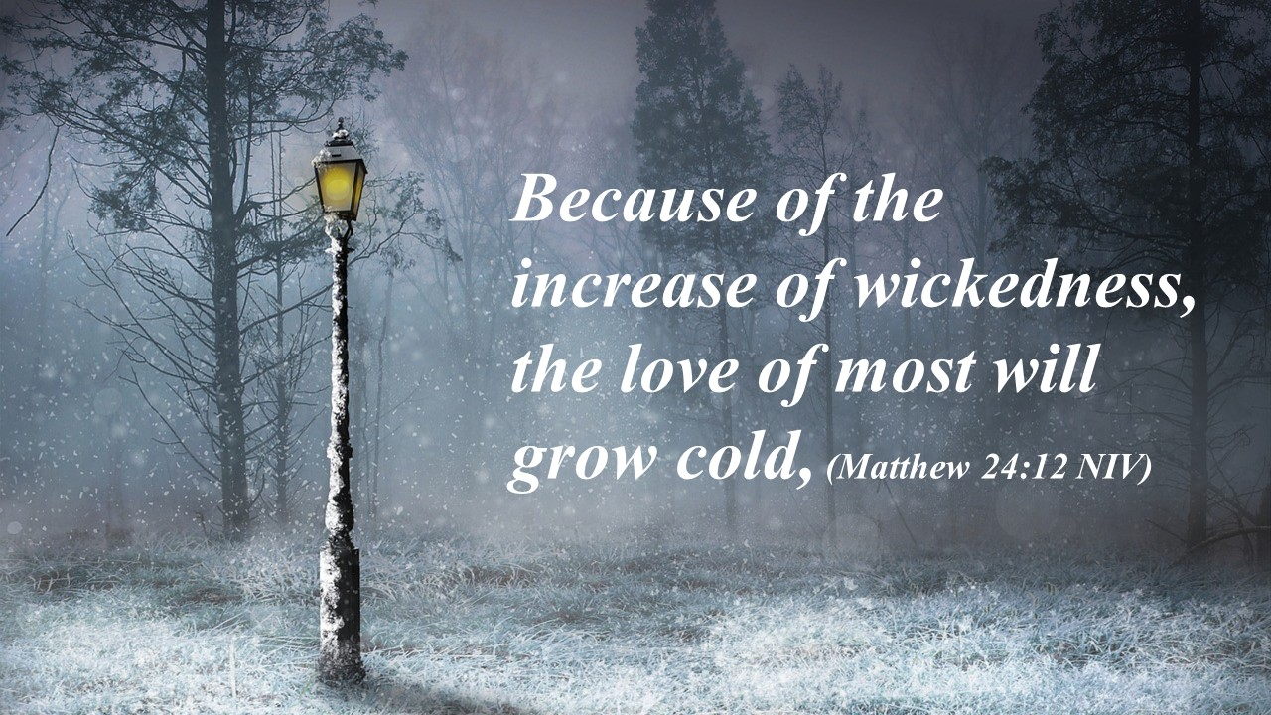

Slide 35
I am going to torch the glacier…

