Slide 2
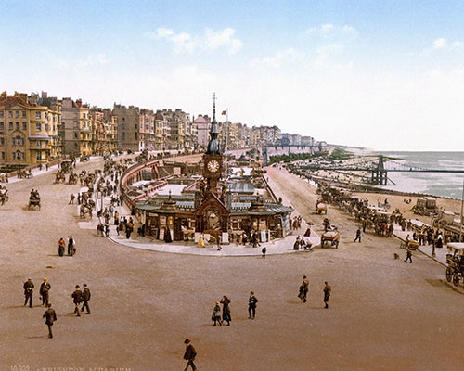

Slide 3
How the CIM was different
Reach the inland provinces
HQ on the field
Depend on God for finances
Cultural and Linguistic identification

Slide 4
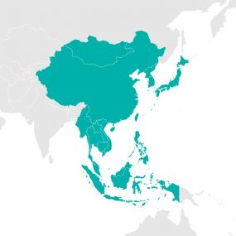
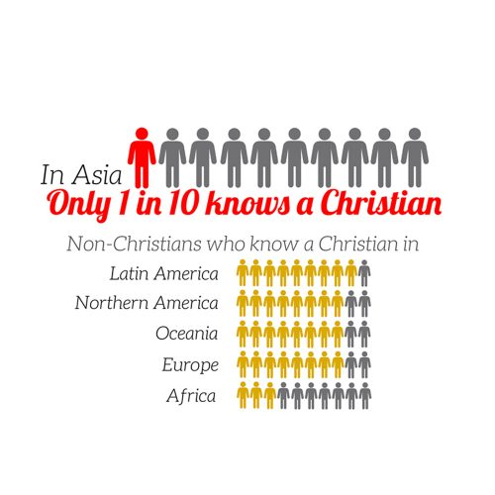

Slide 5
Through God’s grace we aim to see an indigenous biblical church movement in each people group of East Asia, evangelising their own people and reaching out in mission to other peoples.

Slide 7
Now the whole earth had one language and the same words. ² And as people migrated from the east, they found a plain in the land of Shinar and settled there. ³ And they said to one another, “Come, let us make bricks, and burn them thoroughly.” And they had brick for stone, and bitumen for mortar. ⁴ Then they said, “Come, let us build ourselves a city and a tower with its top in the heavens, and let us make a name for ourselves, lest we be dispersed over the face of the whole earth.” ⁵ And the Lord came down to see the city and the tower, which the children of man had built.

Slide 8
⁶ And the Lord said, “Behold, they are one people, and they have all one language, and this is only the beginning of what they will do. And nothing that they propose to do will now be impossible for them. ⁷ Come, let us go down and there confuse their language, so that they may not understand one another's speech.” ⁸ So the Lord dispersed them from there over the face of all the earth, and they left off building the city. ⁹ Therefore its name was called Babel, because there the Lord confused the language of all the earth. And from there the Lord dispersed them over the face of all the earth.

Slide 9
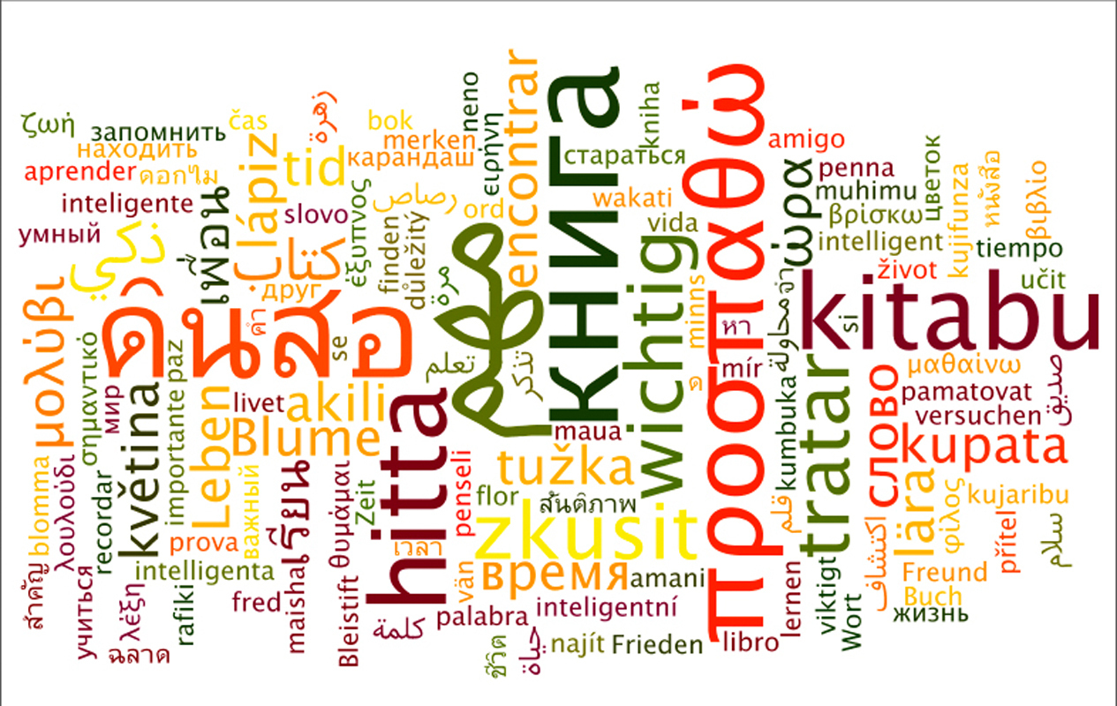

Slide 11
“Now the whole earth had one language and the same words.”

Slide 12
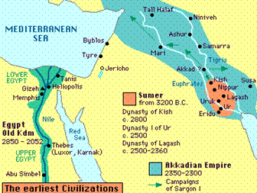
² And as people migrated from (to) the east, they found a plain in the land of Shinar and settled there.

Slide 13
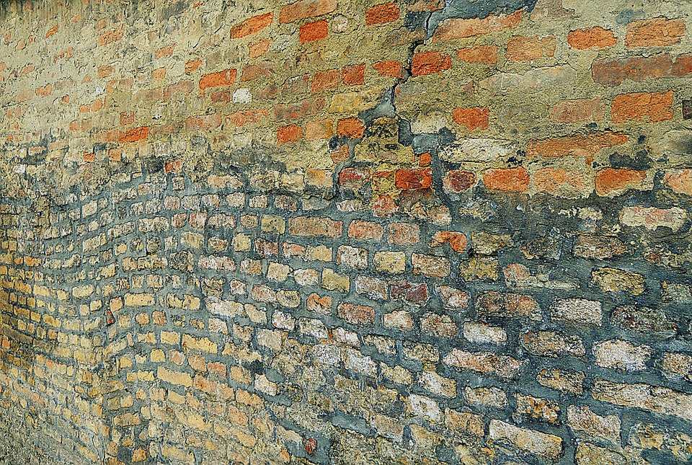
³ And they said to one another, “Come, let us make bricks, and burn them thoroughly.” And they had brick for stone, and bitumen for mortar.

Slide 14
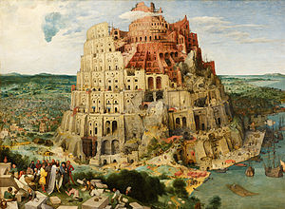
⁴ Then they said, “Come, let us build ourselves a city and a tower with its top in the heavens, and let us make a name for ourselves, lest we be dispersed over the face of the whole earth.”

Slide 15
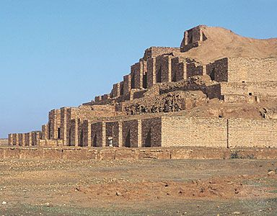
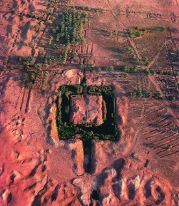

Slide 16
“…for the earth will be full of the knowledge of Adonai, as the waters cover the sea.”

Slide 17
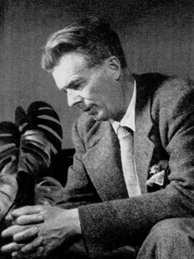
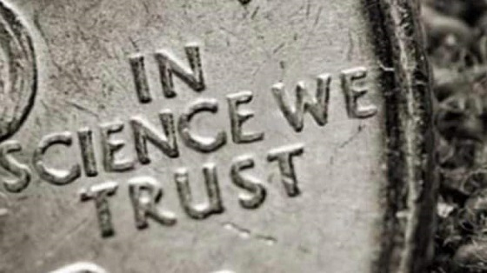
Aldous Huxley

Slide 19
Terry Janke - February 9, 2020
The Flood that Saved the World (Genesis 6—9)

Slide 20
⁴ Then they said, “Come, let us build ourselves a city and a tower with its top in the heavens, and let us make a name for ourselves, lest we be dispersed over the face of the whole earth.”

Slide 21
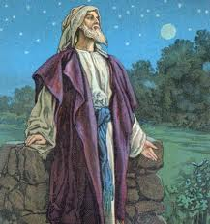
Now the Lord said to Abram, “Go from your country and your kindred and your father's house to the land that I will show you. ² And I will make of you a great nation, and I will bless you and make your name great, so that you will be a blessing.

Slide 22
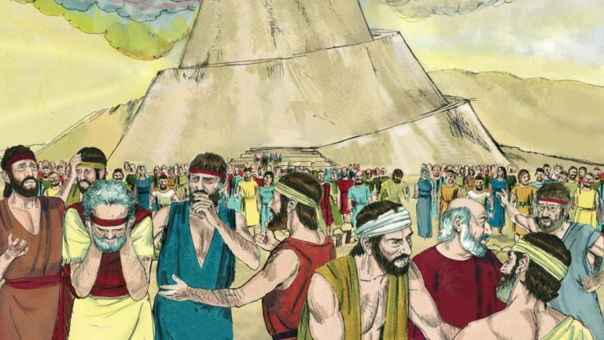
Results (vv. 5-8):
God “came down”
Confused languages
Division
Abandoned the tower and city
“Dispersed across the face of the earth”

Slide 23
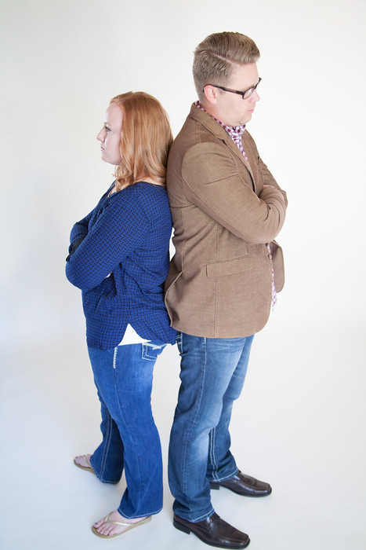
There are doubtless many different languages in the world, and none is without meaning, but if I do not know the meaning of the language, I will be a foreigner to the speaker and the speaker a foreigner to me.

Slide 24
^{Acts 2:6} And at this sound the multitude came together, and they were bewildered, because each one was hearing them speak in his own language.
¹² And all were amazed and perplexed, saying to one another, “What does this mean?”

Slide 25
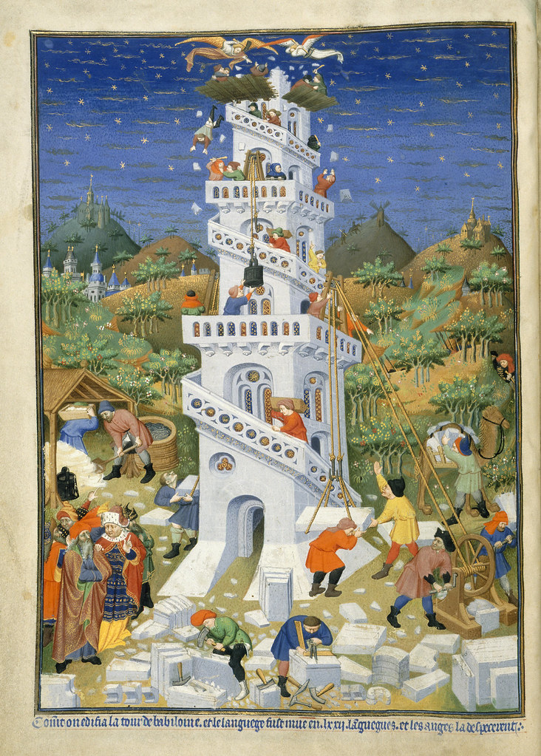
Are we (the Church) guilty of the sins of the builders of Babel?

Slide 26
And God blessed Noah and his sons and said to them, “Be fruitful and multiply and fill the earth.”
Jesus: “Go therefore and make disciples of all nations…”
“Go into all the world and proclaim the gospel to the whole creation.”
“…and you will be my witnesses in Jerusalem and in all Judea and Samaria, and to the end of the earth.”

Slide 27
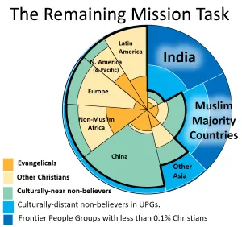

Slide 28
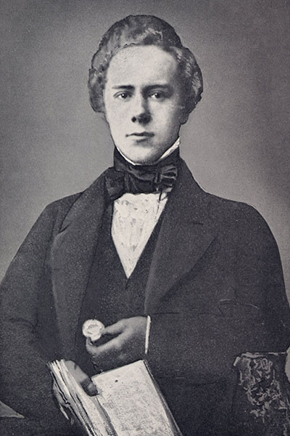

Slide 29
