Slide 3
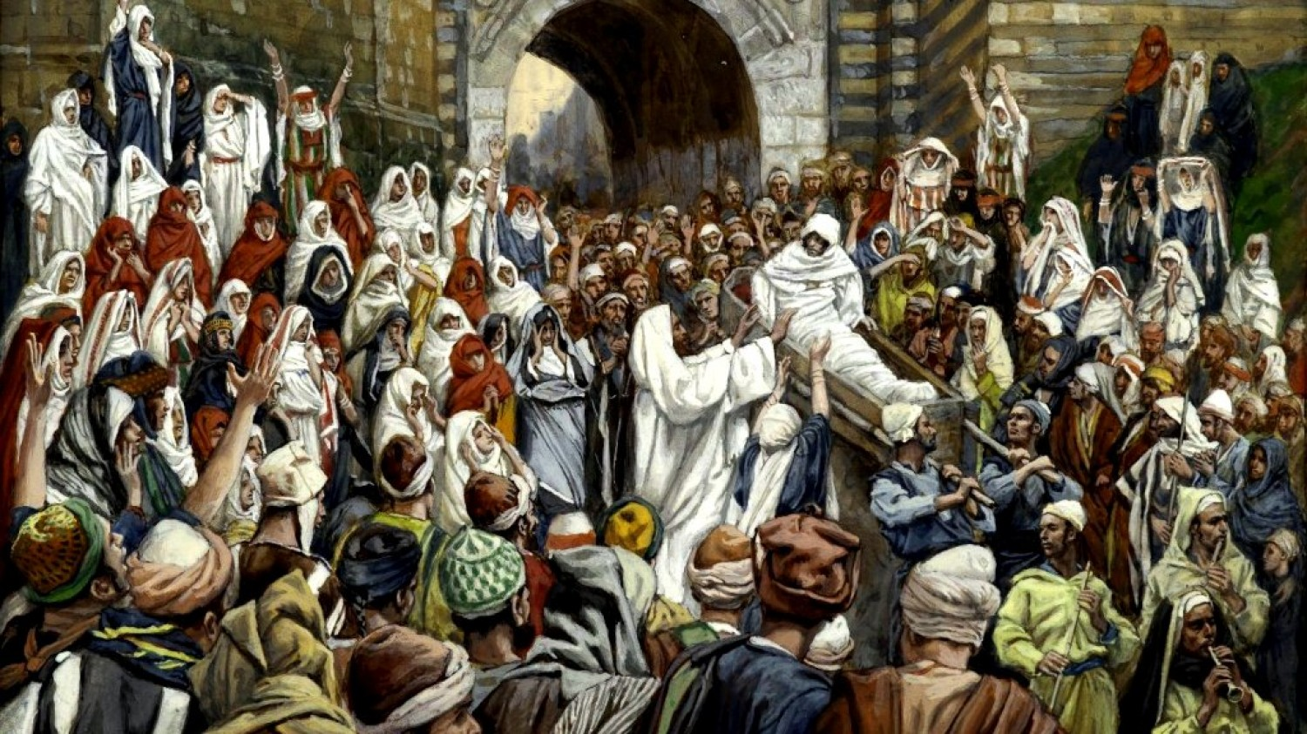

Slide 4
Go and tell John what you have seen and heard: the blind receive their sight, the lame walk, lepers are cleansed, and the deaf hear, the dead are raised up, the poor have good news preached to them. And blessed is the one who is not offended (stumble) because of me. Luke 7:23

Slide 5
The Biblical story arises out of three historical events: the creation of the universe, the intrusion of sin, and the redemption accomplished by Christ. It is a drama in three parts: the happy beginning, the tragic rebellion, and the spectacular finish. – John W. Mahoney, Fallen: A Theology of Sin

Slide 8
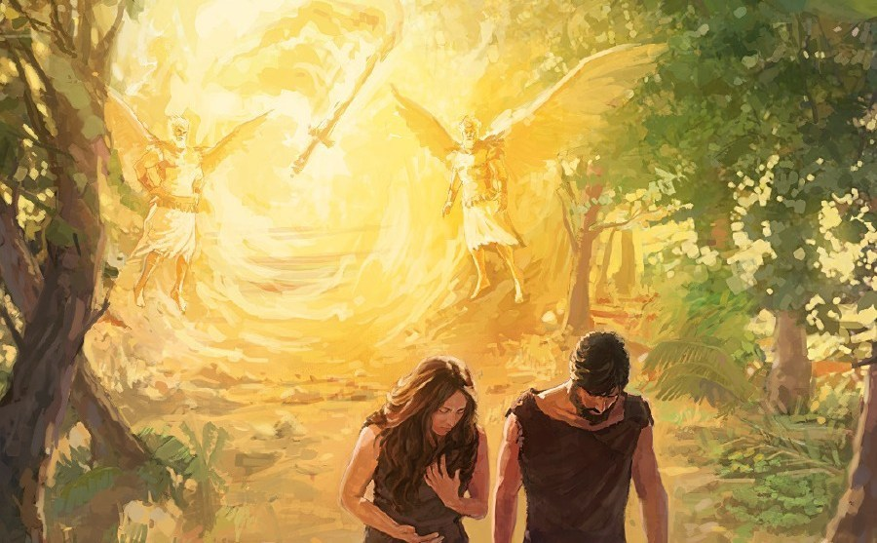

Slide 10
Scripture Reading: Genesis 4:1 - 16

Slide 11
I. Content: The Historical Significance of the Passage

Slide 12
I. Content: The Historical Significance of the Passage
First Giving of a Human Life (4:1 – 2)

Slide 13
I. Content: The Historical Significance of the Passage
First Giving of a Human Life (4:1 – 2)
First Offering made to God (4:3 – 7)

Slide 14
I. Content: The Historical Significance of the Passage
First Giving of a Human Life (4:1 – 2)
First Offering made to God (4:3 – 7)
First Taking of a Human Life (4:8 – 16)

Slide 15
http://www.whyteridgebaptist.ca/urgent-government-of-canada-opens-public-national-consultation-on-assisted-suicide-expansion/

Slide 16
I. Content: The Historical Significance of the Passage
First Giving of a Human Life (4:1 – 2)
First Offering made to God (4:3 – 7)
First Taking of a Human Life (4:8 – 16)

Slide 17
Adam and Eve wanted some corner in the universe of which they could say to God, ‘This is our business, not yours.’ But there is no such corner.
C. S. Lewis, The Problem of Pain)

Slide 18
Sin is man saying to God throughout life, ‘Go away and leave me alone. Hell is God finally saying to man, ‘You may have your wish’. It is God leaving man to himself, as man has chosen.’
Millard Erickson, Fallen: A Theology of Sin)

Slide 19
II. Intent: The Theological Significance of the Passage

Slide 20
The author’s purpose is apparently to use the narrative of Cain and Abel to teach a lesson on the kind of worship that is pleasing to God. Worship that pleases God is that which springs from a pure heart. How does the narrative teach this? By allowing the reader to see, behind the scenes, the response of Cain… Rather than attempting to discover what was wrong with Cain’s offering, we would be better advised to note what was wrong with his heart.
John Sailhamer

Slide 21
II. Intent: The Theological Significance of the Passage
We must learn to offer God our ‘first-fruits’, not just our left-overs.

Slide 22
II. Intent: The Theological Significance of the Passage
We must learn to offer God our ‘first-fruits’, not just our left-overs.
We must learn to offer God our hearts, not just our offerings.

Slide 23
II. Intent: The Theological Significance of the Passage
We must learn to offer God our ‘first-fruits’, not just our left-overs.
We must learn to offer God our hearts, not just our offerings.
We will be ‘spiritual wanderers’ far from God, unless we take responsibility for our sin.

Slide 24
God asks two questions:
Where are you, in relation to Him?
Where are your brothers and sisters, in relation to you?

Slide 25
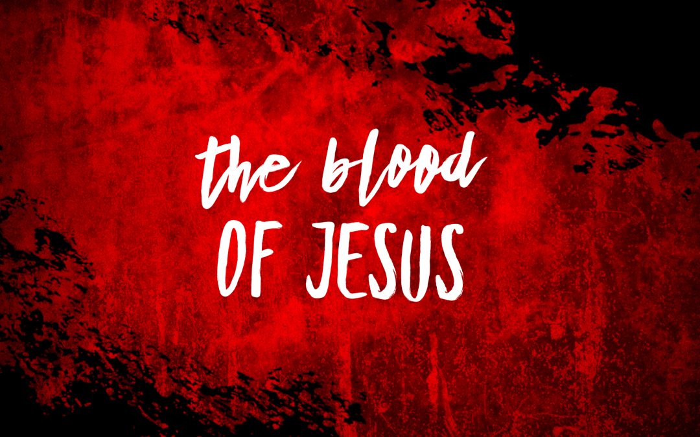
You have come to Jesus, the mediator of a new covenant, and to the sprinkled blood that speaks a better word than the blood of Abel.
Hebrews 12:24

Slide 26
Abel’s blood spoke:
condemnation, vengeance, retribution.
Blood of Jesus speaks:
healing, forgiveness, restoration.

