Slide 3
Genesis 1:26 - 31

Slide 4
Co-Creators with God; capacity to work
Co-Rulers with God; stewards of His creation
Observe Sabbath rest; even as God did.
Spiritual Beings; souls filled with breath of God.
Rational / Moral Beings; capacity to reason, feel, choose.
Relational Beings; capacity for intimacy, love and be loved.
Sexual Beings; male and female.
Genesis 1:26 - 31

Slide 5
1. How are we created to be relational, even as God is relational?
Genesis 1:26 - 31

Slide 6
God is Holy Love.
Genesis 1:26 - 31

Slide 7
Genesis 1:26 - 31

Slide 8
We were created… to long for relational connection, because God exists in a relationship of love. God designed us to enjoy giving and receiving. He designed us to be FOR another… and receive FROM another. This is what it means to be a relational being. Because we bear God’s relational likeness we can commune with God. We also have the capability of connecting with each other in mutually self-flourishing ways.
Richard Plass and James Cofield - The Relational Soul)
Genesis 1:26 - 31

Slide 9
2. How do we as broken image bearers engage in broken relationships?

Slide 10
3. How does healing take place in our relationships through trusting in Jesus Christ?

Slide 11
There is not a square inch in the whole domain of our human existence over which Jesus Christ, who is Sovereign over all, does not cry - 'Mine!‘
Abraham Kuyper

Slide 12
Journeying towards Christ-likeness Together
Our vision at WRBC is:
To make and nurture followers of Jesus Christ through healthy relationships.
Notes:
LifePath
Relationally Based Discipleship
Our purpose at Whyte Ridge Baptist Church is to nurture followers of Jesus Christ through healthy relationships. Acknowledging that, though we cannot create friendships for others, we aim to create a variety of environments where Christ-honouring friendships can either begin to form or continue to develop.
Our key way of reaching this goal are through providing a variety of Connecting Points:

Slide 13
Intimate relationship with God through Jesus Christ
Loving relationships within our own families
Authentic relationships with one another in the Church Family
Caring relationships with our neighbourhoods
Meaningful relationships with people from other cultures
Five Core Relationships
Notes:
LifePath
Relationally Based Discipleship
Our purpose at Whyte Ridge Baptist Church is to nurture followers of Jesus Christ through healthy relationships. Acknowledging that, though we cannot create friendships for others, we aim to create a variety of environments where Christ-honouring friendships can either begin to form or continue to develop.
Our key way of reaching this goal are through providing a variety of Connecting Points:

Slide 14
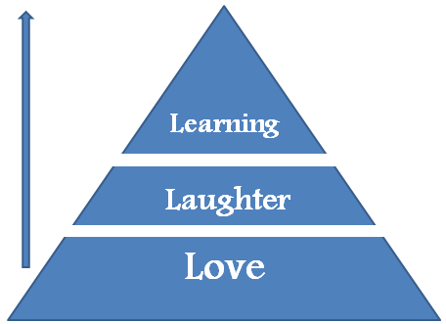
Journeying towards Christ-likeness Together
Our goal is to journey towards Christ-likeness together at a level of intimacy suitable for each person.
Depth of Sharing
Lower
Intimacy
More
Intimate
Intimate
Notes:
Point #1 – being “editors” of each others lives – not word-smiths
Positive Accountability
Wordsmith
- an expert in the use of words.
- a person, as a journalist or novelist, whose vocation is writing.

Slide 15
Notes:
Point #1 – being “editors” of each others lives – not word-smiths
Positive Accountability
Wordsmith
- an expert in the use of words.
- a person, as a journalist or novelist, whose vocation is writing.

Slide 16
The central reality of church is a group of people called to an ever-deepening personal belonging of friendship with Jesus of Nazareth. The command is to abide, to dwell in Him as He dwelt in the Father. You have an image that Jesus used of total intimacy. But Jesus doesn’t give us a deeper relationship with Him apart from His Body.

Slide 17
Jesus does not come alone. He can’t, because Jesus already has a people, He has a family. And when Jesus comes to us He always brings His family with Him. Then we say, ‘No, I just want you. What I have heard about you is fairly good, but what I’ve heard about your family is not so good. And Jesus says, ‘We come together.’
Gordon Cosby

