Slide 2
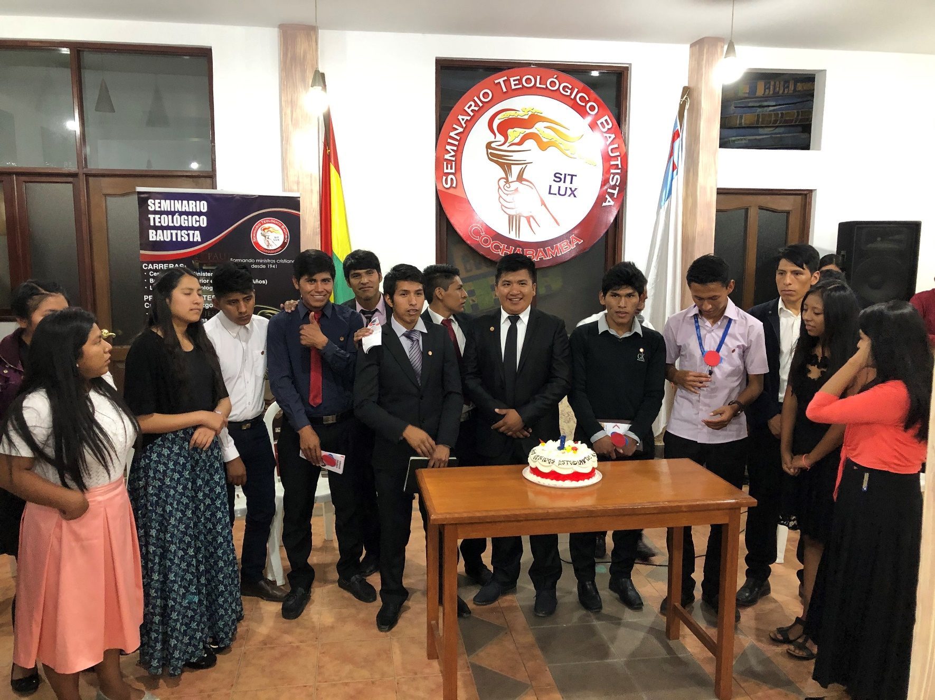
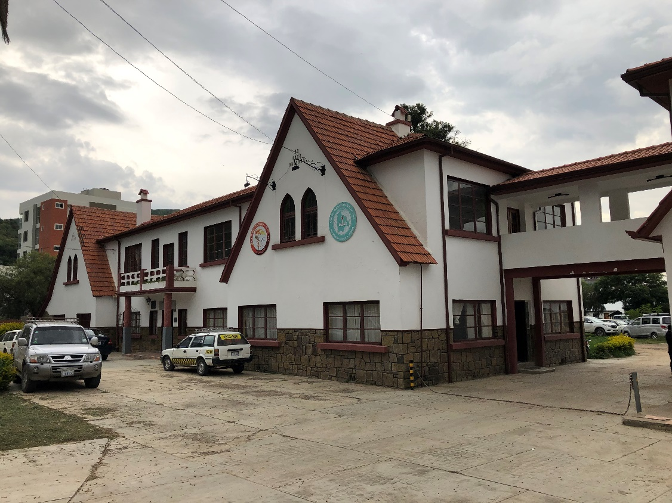

Slide 3
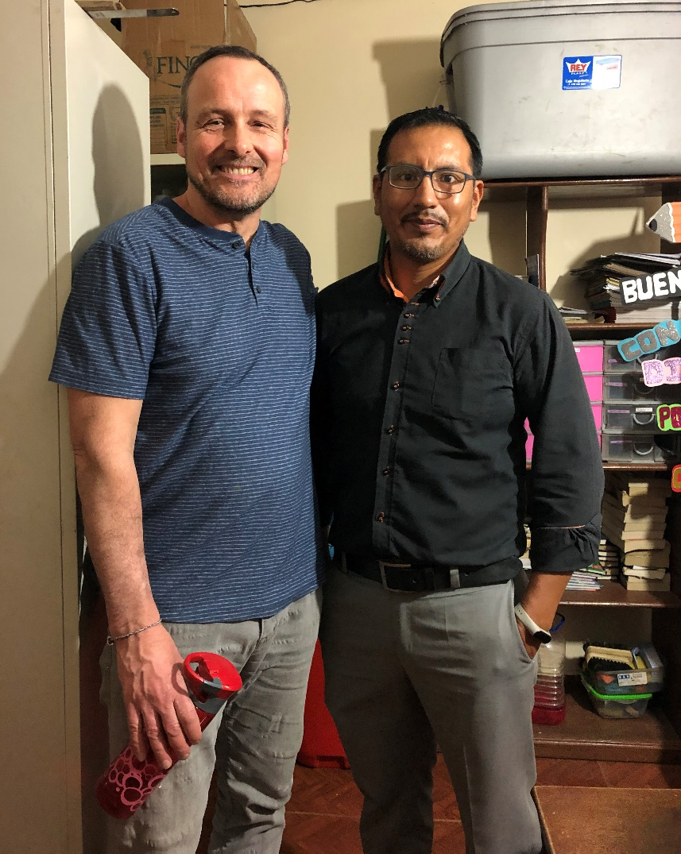
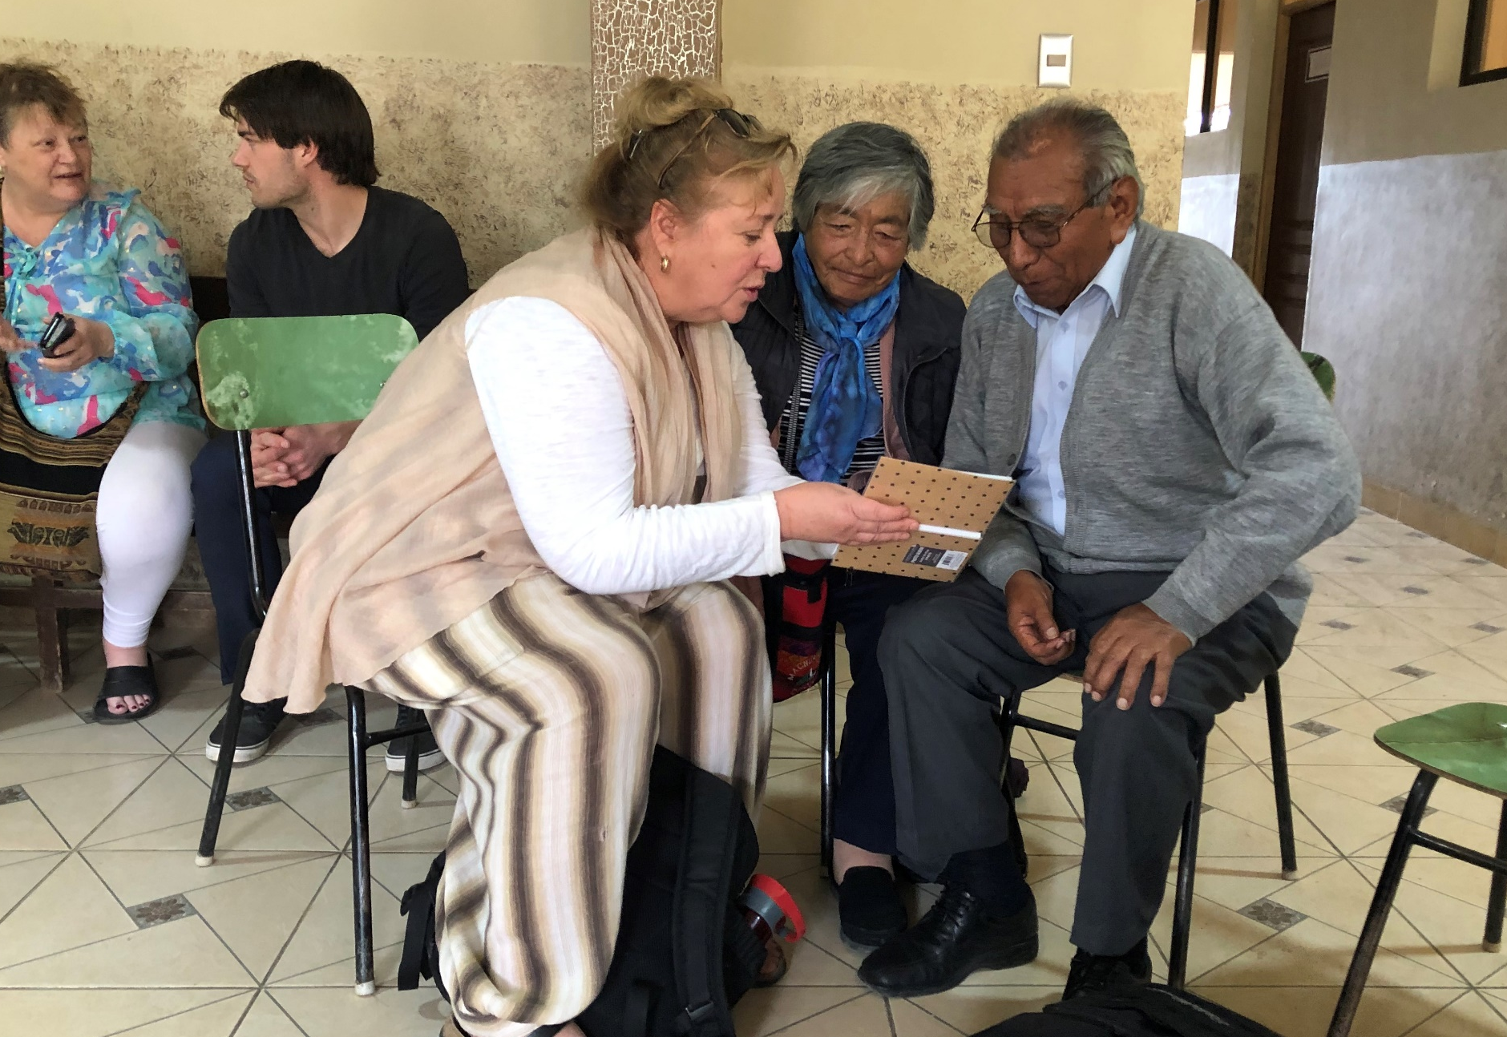

Slide 4
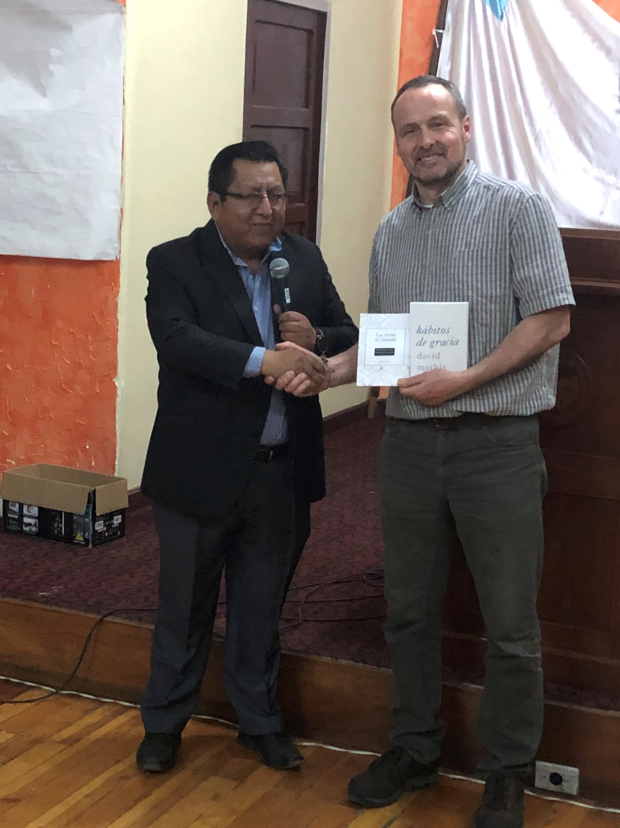

Slide 5
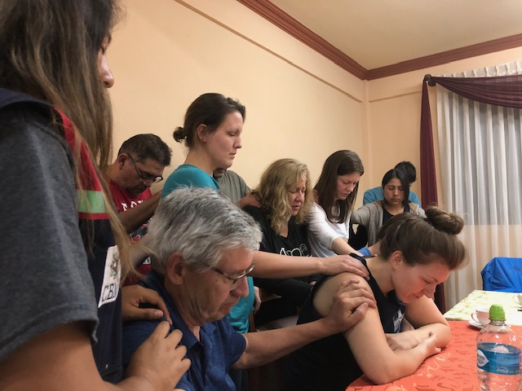

Slide 7
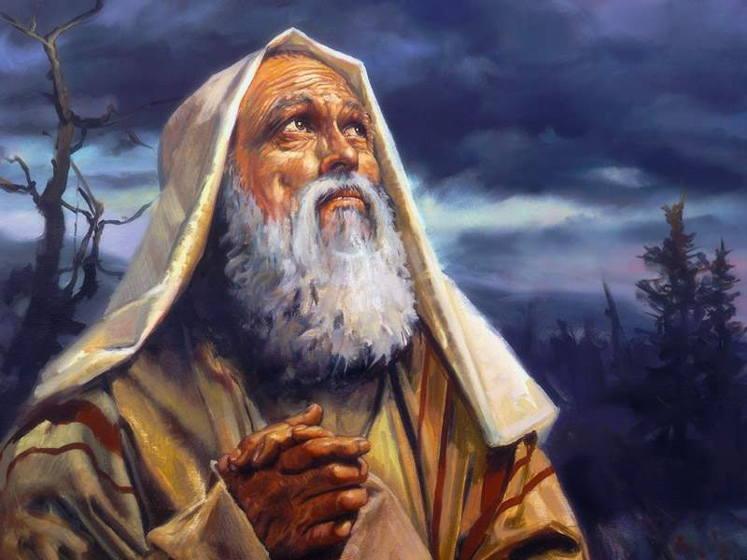
The Means and Measures God Uses to Mature our Faith Genesis 17 – A Study from the Life of Abraham

Slide 8
“
The Maturing of our Relationship with God:
Happens over time.
Happens through ‘faith tests’.

Slide 9
“
Scripture Reading:
Genesis 17:1 - 8

Slide 10
“
Faith Hall of Fame (Hebrews 11)
Abraham: Overview of Three Kinds of Faith:
Uprooting Faith - Gen.12:1; Heb.11:8.
Waiting Faith - Gen.17-18; Heb.11:11.
Sacrificial Faith - Gen.22; Heb.11:17-19.

Slide 11
“
Abraham: Timelines of Maturity:
12:4 – First Call (Age 75).
15:5 – Covenant made (+/- Age 80?)
16:16 – Ishmael is born (Age 86).
17:1 – Re-establishes Covenant (Age 99).
21:5 – Isaac is born (Age 100).
22:6 – Asked to sacrifice Isaac (+/- Age 120).
23:1 – Sarah dies (Abraham, Age 137).
25:7 – Abraham dies (Age 175).

Slide 12
“
Abraham: Emerging from Spiritual Adolescence

Slide 13
“
Abraham: Emerging from Spiritual Adolescence
i. A New Posture before God (17:2 - 3, 17)

Slide 14
“
Abraham: Emerging from Spiritual Adolescence
i. A New Posture before God (17:2 - 3, 17)
ii. A New Identity from God (17:5 - 6, 15 - 16)

Slide 15
“
Abraham: Emerging from Spiritual Adolescence
i. A New Posture before God (17:2 - 3, 17)
ii. A New Identity from God (17:5 - 6, 15 - 16)
iii. A New Relationship (Covenant) with God (17:9 – 14)

Slide 16
“
Abraham: Emerging from Spiritual Adolescence
i. A New Posture before God (17:2 - 3, 17)
ii. A New Identity from God (17:5 - 6, 15 - 16)
iii. A New Relationship (Covenant) with God (17:9 – 14)
iv. A New Obedience to God (17:23 – 27)

Slide 17
“
Emerging from Spiritual Adolescence
I write to you young men, because you are strong, and the Word of God abides in you, and you have overcome the evil one.
1 John 2:14

Slide 18
“
Emerging from Spiritual Adolescence
Where would you place your own spiritual development as of right now?

Slide 19
“
Emerging from Spiritual Adolescence
Where would you place your own spiritual development as of right now?
Is there anything about Abraham that surprises you?

Slide 20
“
Emerging from Spiritual Adolescence
Where would you place your own spiritual development as of right now?
Is there anything about Abraham that surprises you?
Have you ever been set on a plan that was not in God’s plans?

Slide 21
“
Emerging from Spiritual Adolescence
Where would you place your own spiritual development as of right now?
Is there anything about Abraham that surprises you?
Have you ever been set on a plan that was not in God’s plans?
How would you describe your posture (attitude), your identity, your relationship, and your obedience to God today?

