Slide 3
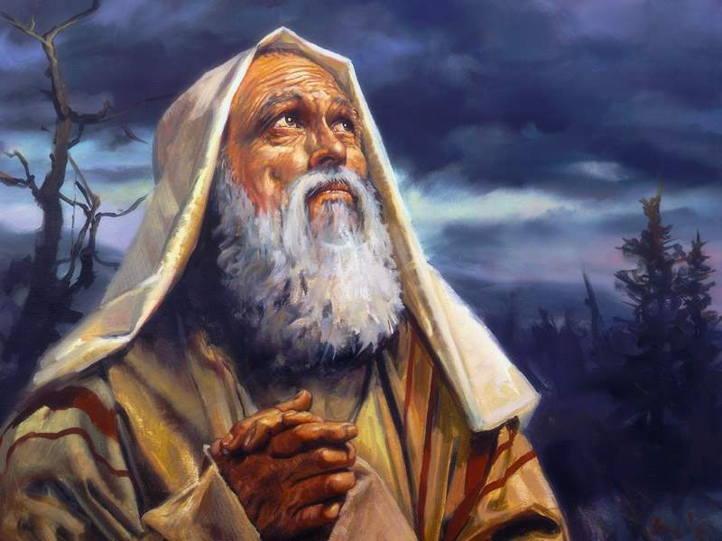
“
The Birth of Isaac:
A Lesson in the Covenant of Grace

Slide 4
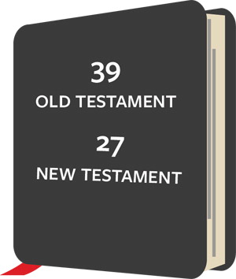
“

Slide 5
“
Scripture Readings:
Old Testament: Genesis 21:1 – 7
New Testament: Galatians 4:21 – 5:1

Slide 6
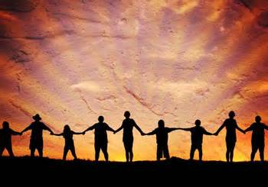
“
Who are the true people of God?

Slide 7
“
Pray
Worship
Read
Study
Share
Do good

Slide 8
“
Who are the true people of God?

Slide 9
“
OT Story NT Significance
Historical facts - Figurative meaning
Content - Intent

Slide 10
“
OT Story: Told through lens of Laughter

Slide 11
“
OT Story: Told through lens of Laughter
Spontaneous laughter (17:17)

Slide 12
“
OT Story: Told through lens of Laughter
Spontaneous laughter (17:17)
Sarcastic laughter (18:12)

Slide 13
“
OT Story: Told through lens of Laughter
Spontaneous laughter (17:17)
Sarcastic laughter (18:12)
Scornful laughter (19:14)

Slide 14
“
OT Story: Told through lens of Laughter
Spontaneous laughter (17:17)
Sarcastic laughter (18:12)
Scornful laughter (19:14)
Shared laughter (21:6)

Slide 15
“
OT Story: Told through lens of Laughter
Spontaneous laughter (17:17)
Sarcastic laughter (18:12)
Scornful laughter (19:14)
Shared laughter (21:6)
Sneering laughter (21:9)

Slide 16
“
NT Significance: Understood through Freedom in Christ (Gal. 4:21 – 5:1)
Sons of different Mothers (4:21 - 23)

Slide 17
“
Legalism focuses on:
External behavior instead of the heart.

Slide 18
“
Legalism focuses on:
External behavior instead of the heart. Performance instead of Christ’s payment.

Slide 19
“
Legalism focuses on:
External behavior instead of the heart. Performance instead of Christ’s payment. Rule-keeping instead of a loving relationship.

Slide 20
“
Legalism focuses on:
External behavior instead of the heart. Performance instead of Christ’s payment. Rule-keeping instead of a loving relationship. Bondage to, instead of freedom from.

Slide 21
“
NT Significance: Understood through Freedom in Christ (Gal. 4:21 – 5:1)
Sons of different Mothers (4:21 - 23)
Mothers of different Rel’ps (4:24 - 27)

Slide 22
“
NT Significance: Understood through Freedom in Christ (Gal. 4:21 – 5:1)
Sons of different Mothers (4:21 - 23)
Mothers of different Rel’ps (4:24 - 27)
Births of a different nature (4:28 – 31)

Slide 23
“
NT Significance: Understood through Freedom in Christ (Gal. 4:21 – 5:1)
Sons of different Mothers (4:21 - 23)
Mothers of different Rel’ps (4:24 - 27)
Births of a different nature (4:28 – 31)
Children who live in Freedom (5:1)

Slide 24
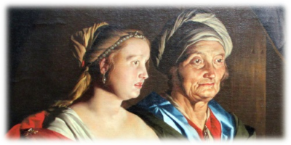
“
Sarah… received power to conceive, even when she was past the age (Heb. 11:11)

Slide 25
“
Sarah… received power to conceive, even when she was past the age (Heb. 11:11)
Abraham… as good as dead (Heb. 11:12)

Slide 26
“
Who are the people of God?

