Slide 2
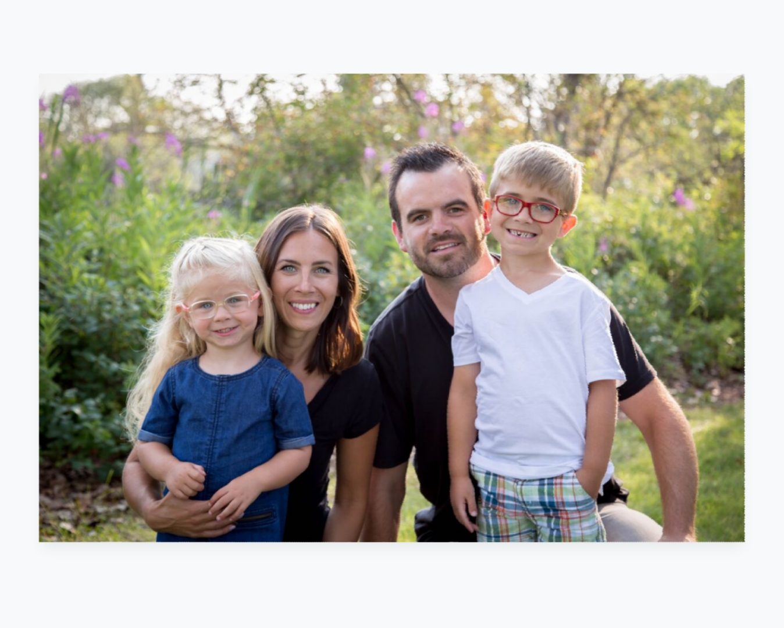

Slide 6
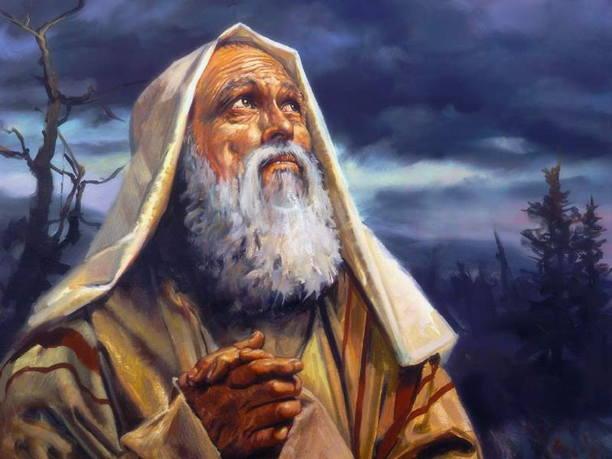
“

Slide 7
“
Abraham: Emerging from Spiritual Adolescence
i. A New Posture before God (17:2 - 3, 17)
ii. A New Identity from God (17:5 - 6, 15 - 16)
iii. A New Relationship with God (17:9 - 14)
iv. A New Obedience to God (17:23 – 27)

Slide 8
Scripture Reading: Genesis 18:22 - 33

Slide 9
‘The sign of a good story is that even when you are done with it, it is not done with you.’ William J. Bausch

Slide 10
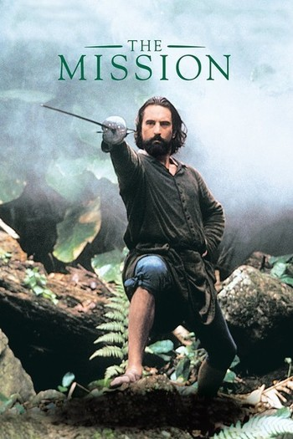

Slide 11
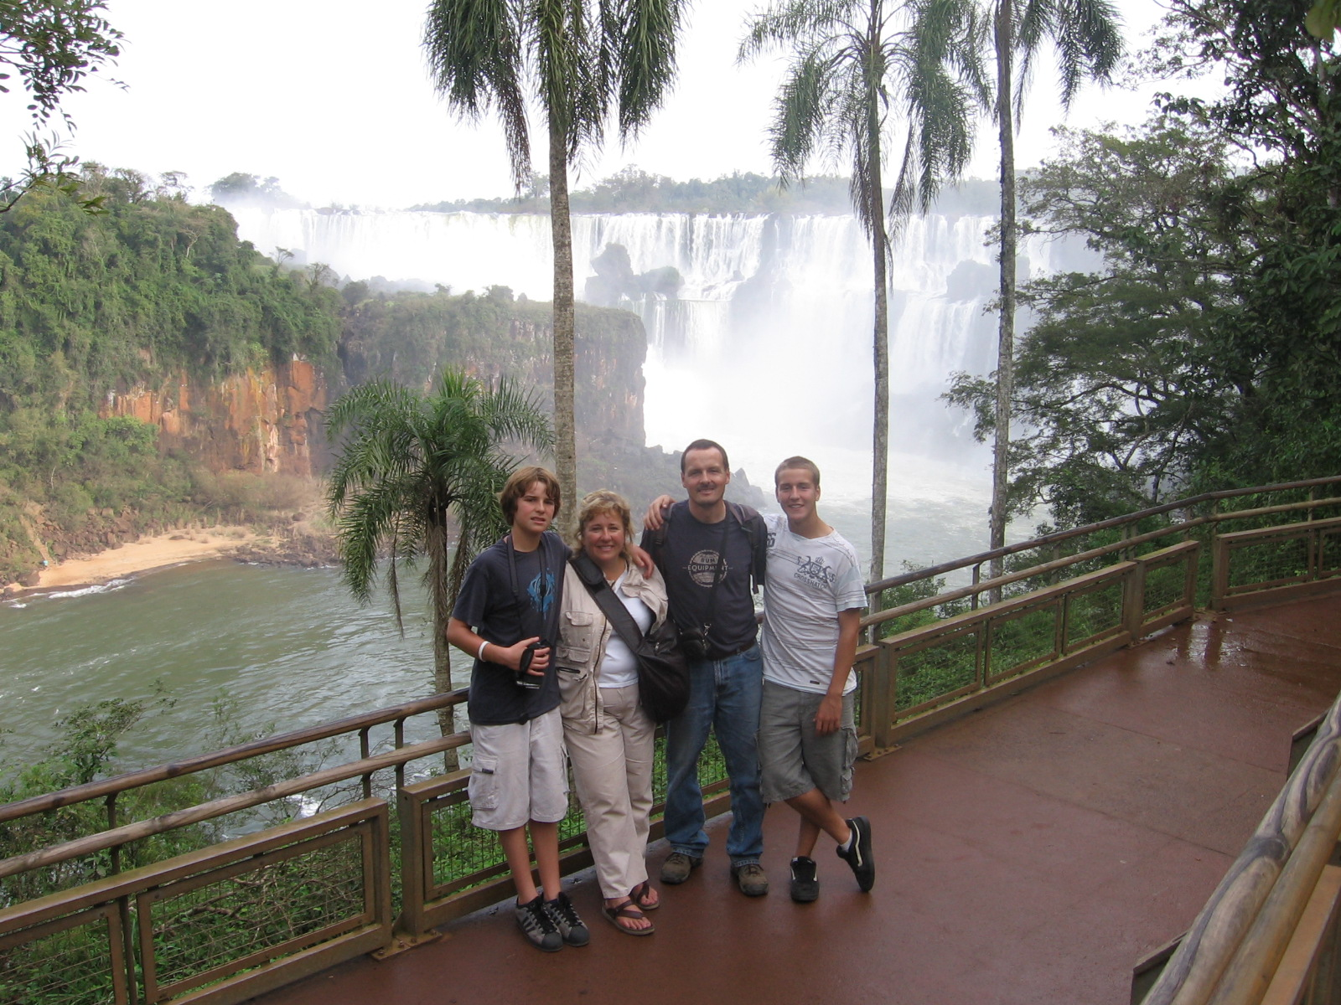

Slide 12
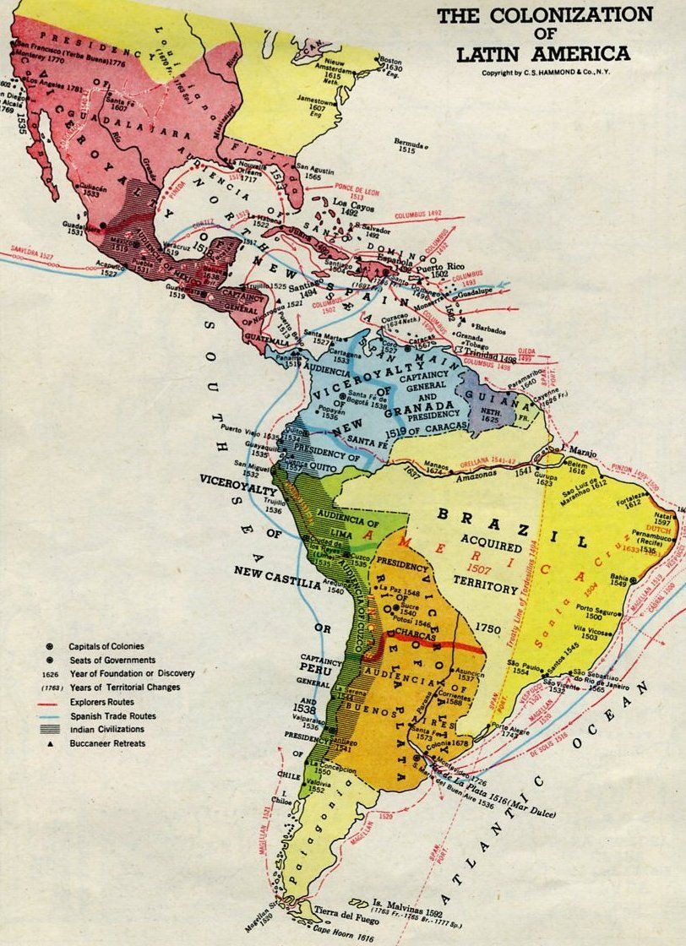

Slide 14
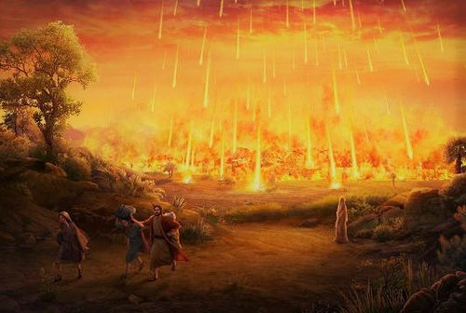

Slide 17
‘The Lord appeared to Abraham by the oaks of Mamre…’ Genesis 18:1

Slide 18
‘He lifted up his eyes and looked, and behold three men were standing in front of him.’ Genesis 18:2

Slide 19
The Lord said, Because the outcry against Sodom and Gomorrah is great and their sin is very grave, I will go down to see whether they have done altogether according to the outcry that has come to me. And if not, I will know. (18:20)

Slide 20
‘So the men turned from there and went toward Sodom, but Abraham still stood before the Lord.’ (18:22)

Slide 21
‘And the LORD went His way, when He had finished speaking to Abraham, and Abraham returned to His place.’ (18:33)

Slide 22
‘The two angels came to Sodom in the evening…’ (19:1)

Slide 23
Prayer that Responds to the Mercy of God (18:16 – 21; 19:13)

Slide 24
Prayer that Responds to the Mercy of God (18:16 – 21; 19:13) Prayer that takes a Stand for the Justice of God (18:22 – 33; 19:27)

Slide 25
Prayer that Responds to the Mercy of God (18:16 – 21; 19:13) Prayer that takes a Stand for the Justice of God (18:22 – 33; 19:27) Prayer that Aligns with the Purposes of God (19:1 - 29)

Slide 26
Prayer that Responds to the Mercy of God (18:16 – 21; 19:13) Prayer that takes a Stand for the Justice of God (18:22 – 33; 19:27) Prayer that Aligns with the Purposes of God (19:1 - 29) Prayer that leaves a Legacy in the Will of God (19:30 – 38)

Slide 27
‘Holy sexuality consists of two paths: chastity in singleness and faithfulness in marriage.’ Christopher Yuan

Slide 28
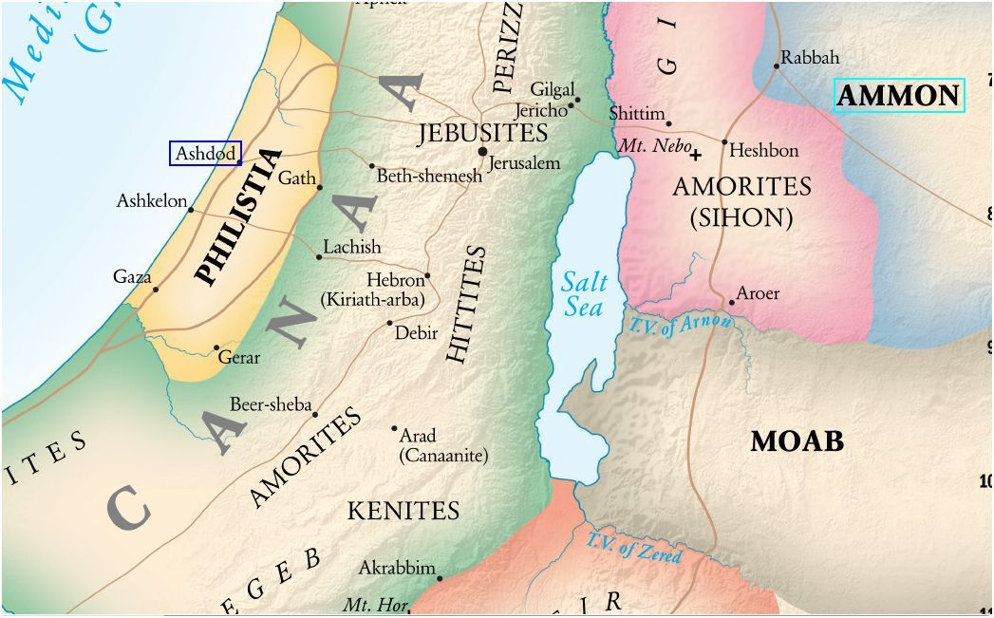

Slide 29
‘I used to think if you fell from grace it was more likely than not the result of one stupendous error, or else an unfortunate accident. I hadn’t learned that it can happen so gradually you don’t lose your stomach or hurt yourself in the landing.’ Jane Hamilton

Slide 30
Questions for Reflection, Discussion and Application:

Slide 33
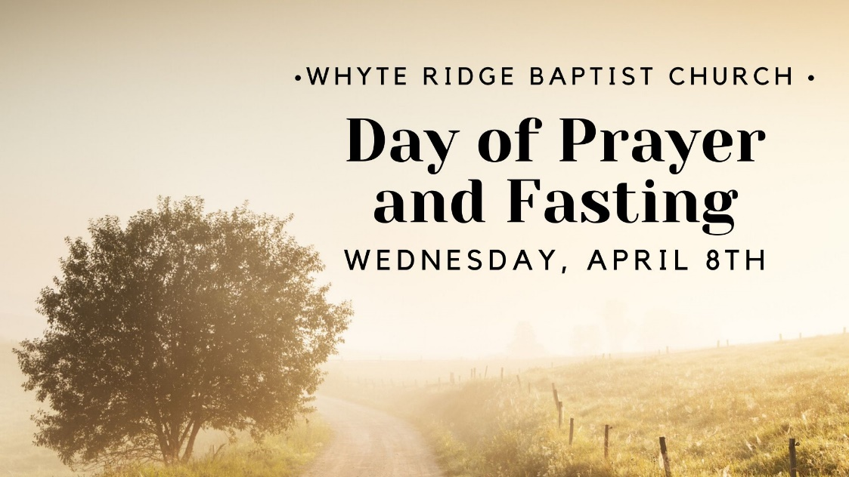
‘And he stood between the dead and the living, and the plagues was stopped.’
Numbers 16:48

