Slide 2
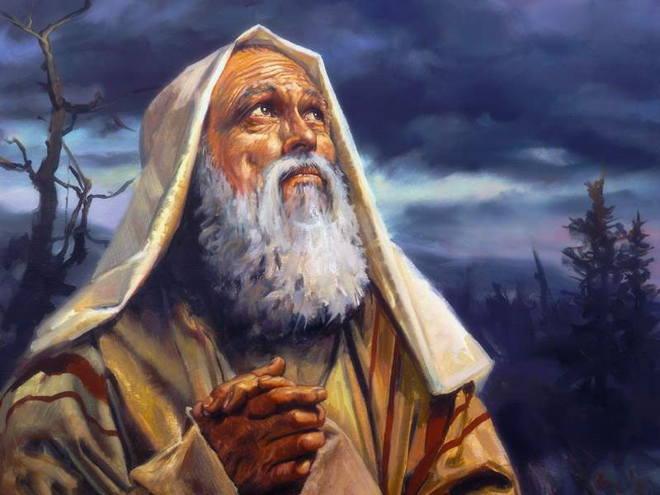
“
Faith Tests in Abraham’s Life

Slide 3
“
Abraham’s Faith Tests: Big Three
- Tests that require Change (11:8 – 10)
- Tests that require Patience (11:11 – 12)
- Tests that require Sacrifice (11:17 – 19)

Slide 4
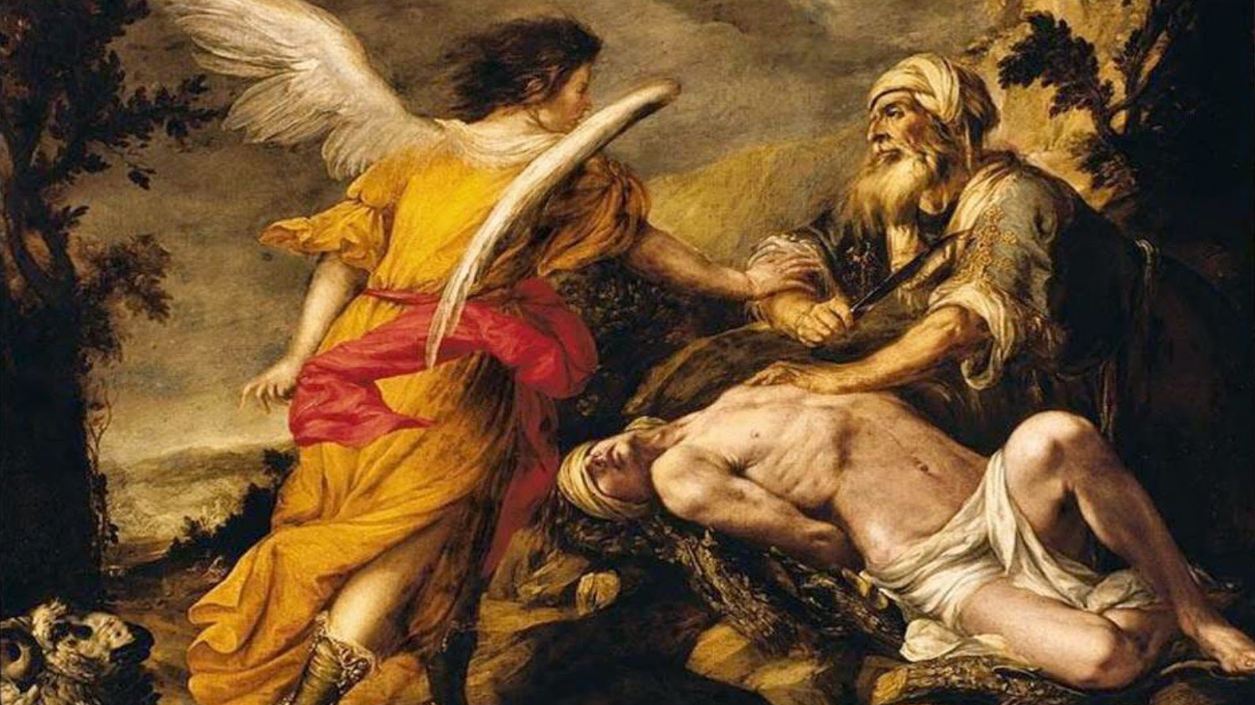
“

Slide 5
“
An ‘Isaac-like’ Experience,
by Joy Loewen

Slide 7
“
An ‘Isaac-like’ Experience,
by Joy Loewen

Slide 8
“

Slide 9
“
Scripture Readings:
Genesis 24:1 – 28

Slide 10
“
Fatalism
vs.
Self-Determinism

Slide 11
“
Abraham’s final Faith Test:
Passing on a Legacy of Faith

Slide 12
“
Abraham’s CPP:
(Covenantal Parenting Plan)

Slide 13
“
Abraham’s CPP: Three Imperatives
Isaac needs to find a wife

Slide 14
“
Abraham’s CPP: Three Imperatives
Isaac needs to find a wife
She must not be a Canaanite

Slide 15
“
Abraham’s CPP: Three Imperatives
Isaac needs to find a wife
She must not be a Canaanite
He must not return to land of their fore-fathers

Slide 16
“
CPP for Christian Parents:
Christian Parenting Priorities
(or Prayers)

Slide 17
“
There is a tendency on the part of many Christian parents to be more worried about the world of the seen, than the world of the unseen, especially when it comes to our teenagers.

Slide 18
“
CPP: Christian Parents Praying:
- Give our children significant others worthy of life-long friendship.

Slide 19
“
CPP: Christian Parents Praying:
Give our children significant others worthy of life-long friendship.
Let these ‘significant others’ be a godly influence in their lives.

Slide 20
“
CPP: Christian Parents Praying:
Give our children significant others worthy of life-long friendship.
Let these ‘significant others’ be a godly influence in their lives.
Let them not turn back to a life without God, but grow in faith and witness.

Slide 21
“
Just keep walking…

Slide 22
“
Just keep walking…
The legacy of faith you leave behind is determined with each day that you live by faith.

Slide 23
“
Just keep walking…
The Lord, before whom I have walked, will send His angel with you and prosper your way. – Gen. 24:40

Slide 24
“
Questions for Reflection…
When you think about your biggest dreams and prayers for your children, how many of them are temporal and how many are eternal?

Slide 25
“
Questions for Reflection…
When you think about your biggest dreams and prayers for your children, how many of them are temporal and how many are eternal?
What part of the message today has landed on your heart? How might you pray differently for your family and children?

Slide 26
“

