Slide 4
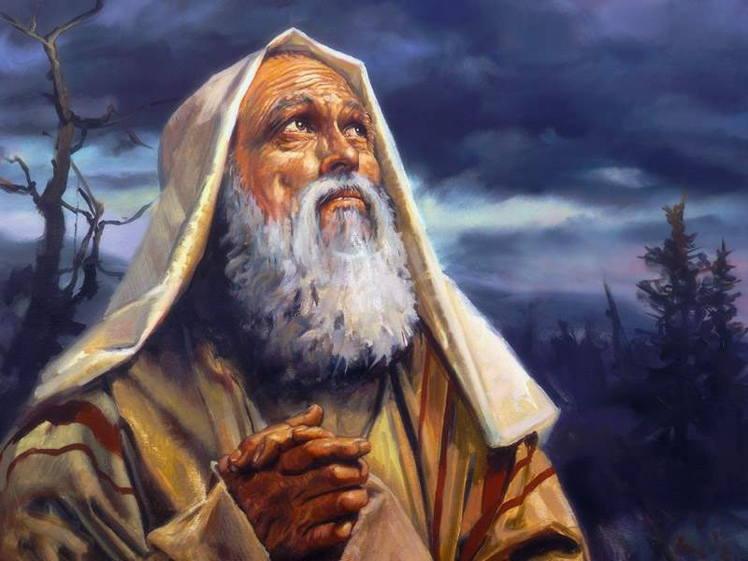
“
Scripture Readings:
Genesis 22:1 – 14
Hebrews 11:17 - 19

Slide 6
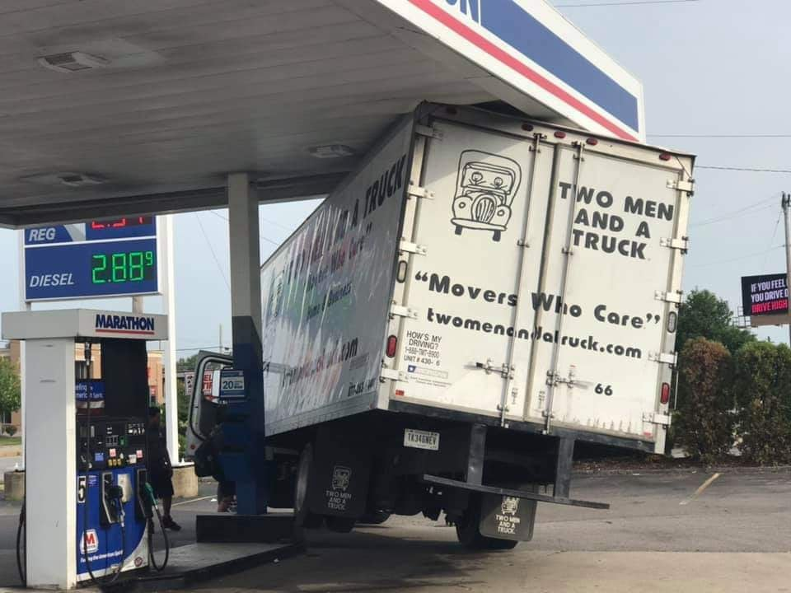

Slide 8
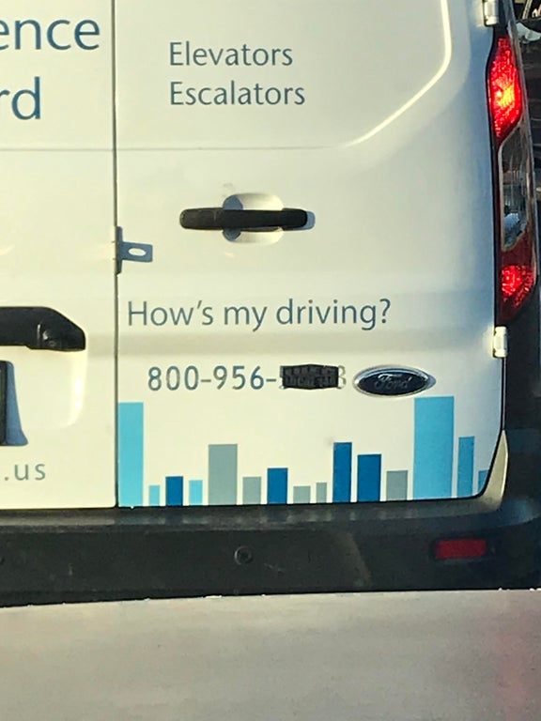

Slide 9
“

Slide 10
“
Test - the means by which the presence, quality, or genuineness of anything is determined.

Slide 11
“

Slide 12
“

Slide 13
“
Faith Tests… Why?
- To know what was in your heart…
- To know whether you love the Lord…
- To know whether Israel would obey…
- To know all that was in his heart…
- To know that you fear God…

Slide 14
“

Slide 15
“

Slide 16
“
Abraham’s Faith Tests: Big Three

Slide 17
“
Abraham’s Faith Tests: Big Three
- Tests that require Change (11:8 – 10)

Slide 18
“
Abraham’s Faith Tests: Big Three
- Tests that require Change (11:8 – 10)
- Tests that require Patience (11:11 – 12)

Slide 19
“
Abraham’s Faith Tests: Big Three
- Tests that require Change (11:8 – 10)
- Tests that require Patience (11:11 – 12)
- Tests that require Sacrifice (11:17 – 19)

Slide 20
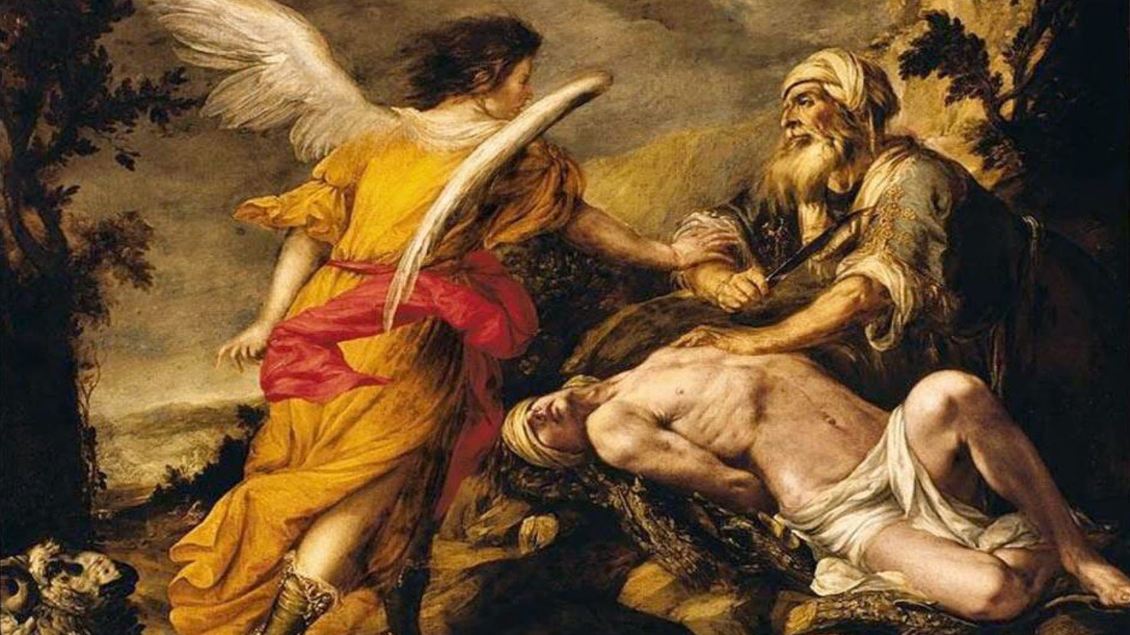
“

Slide 21
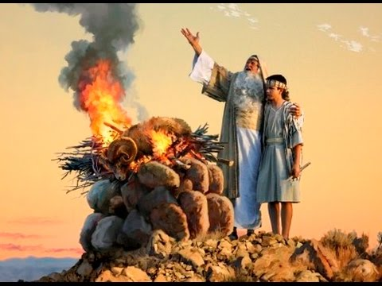
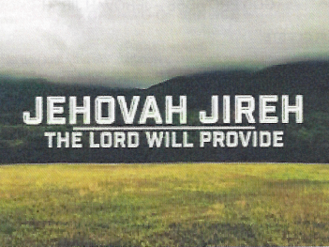
“
Abraham’s Faith in God

Slide 22
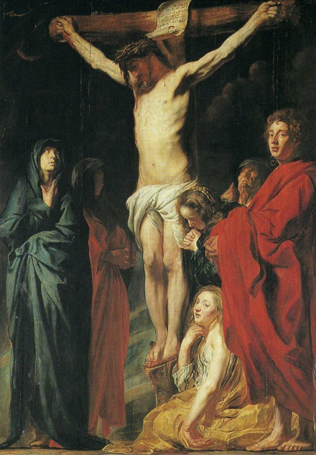
“

Slide 23
“
Our Faith in God

Slide 24
“
Faith Tests in our Lives:
Learning from Abraham

